Slide 1

STATE OF THE VILLAGE
HOMER GLEN
Mayor George Yukich
April 16, 2019

Slide 2
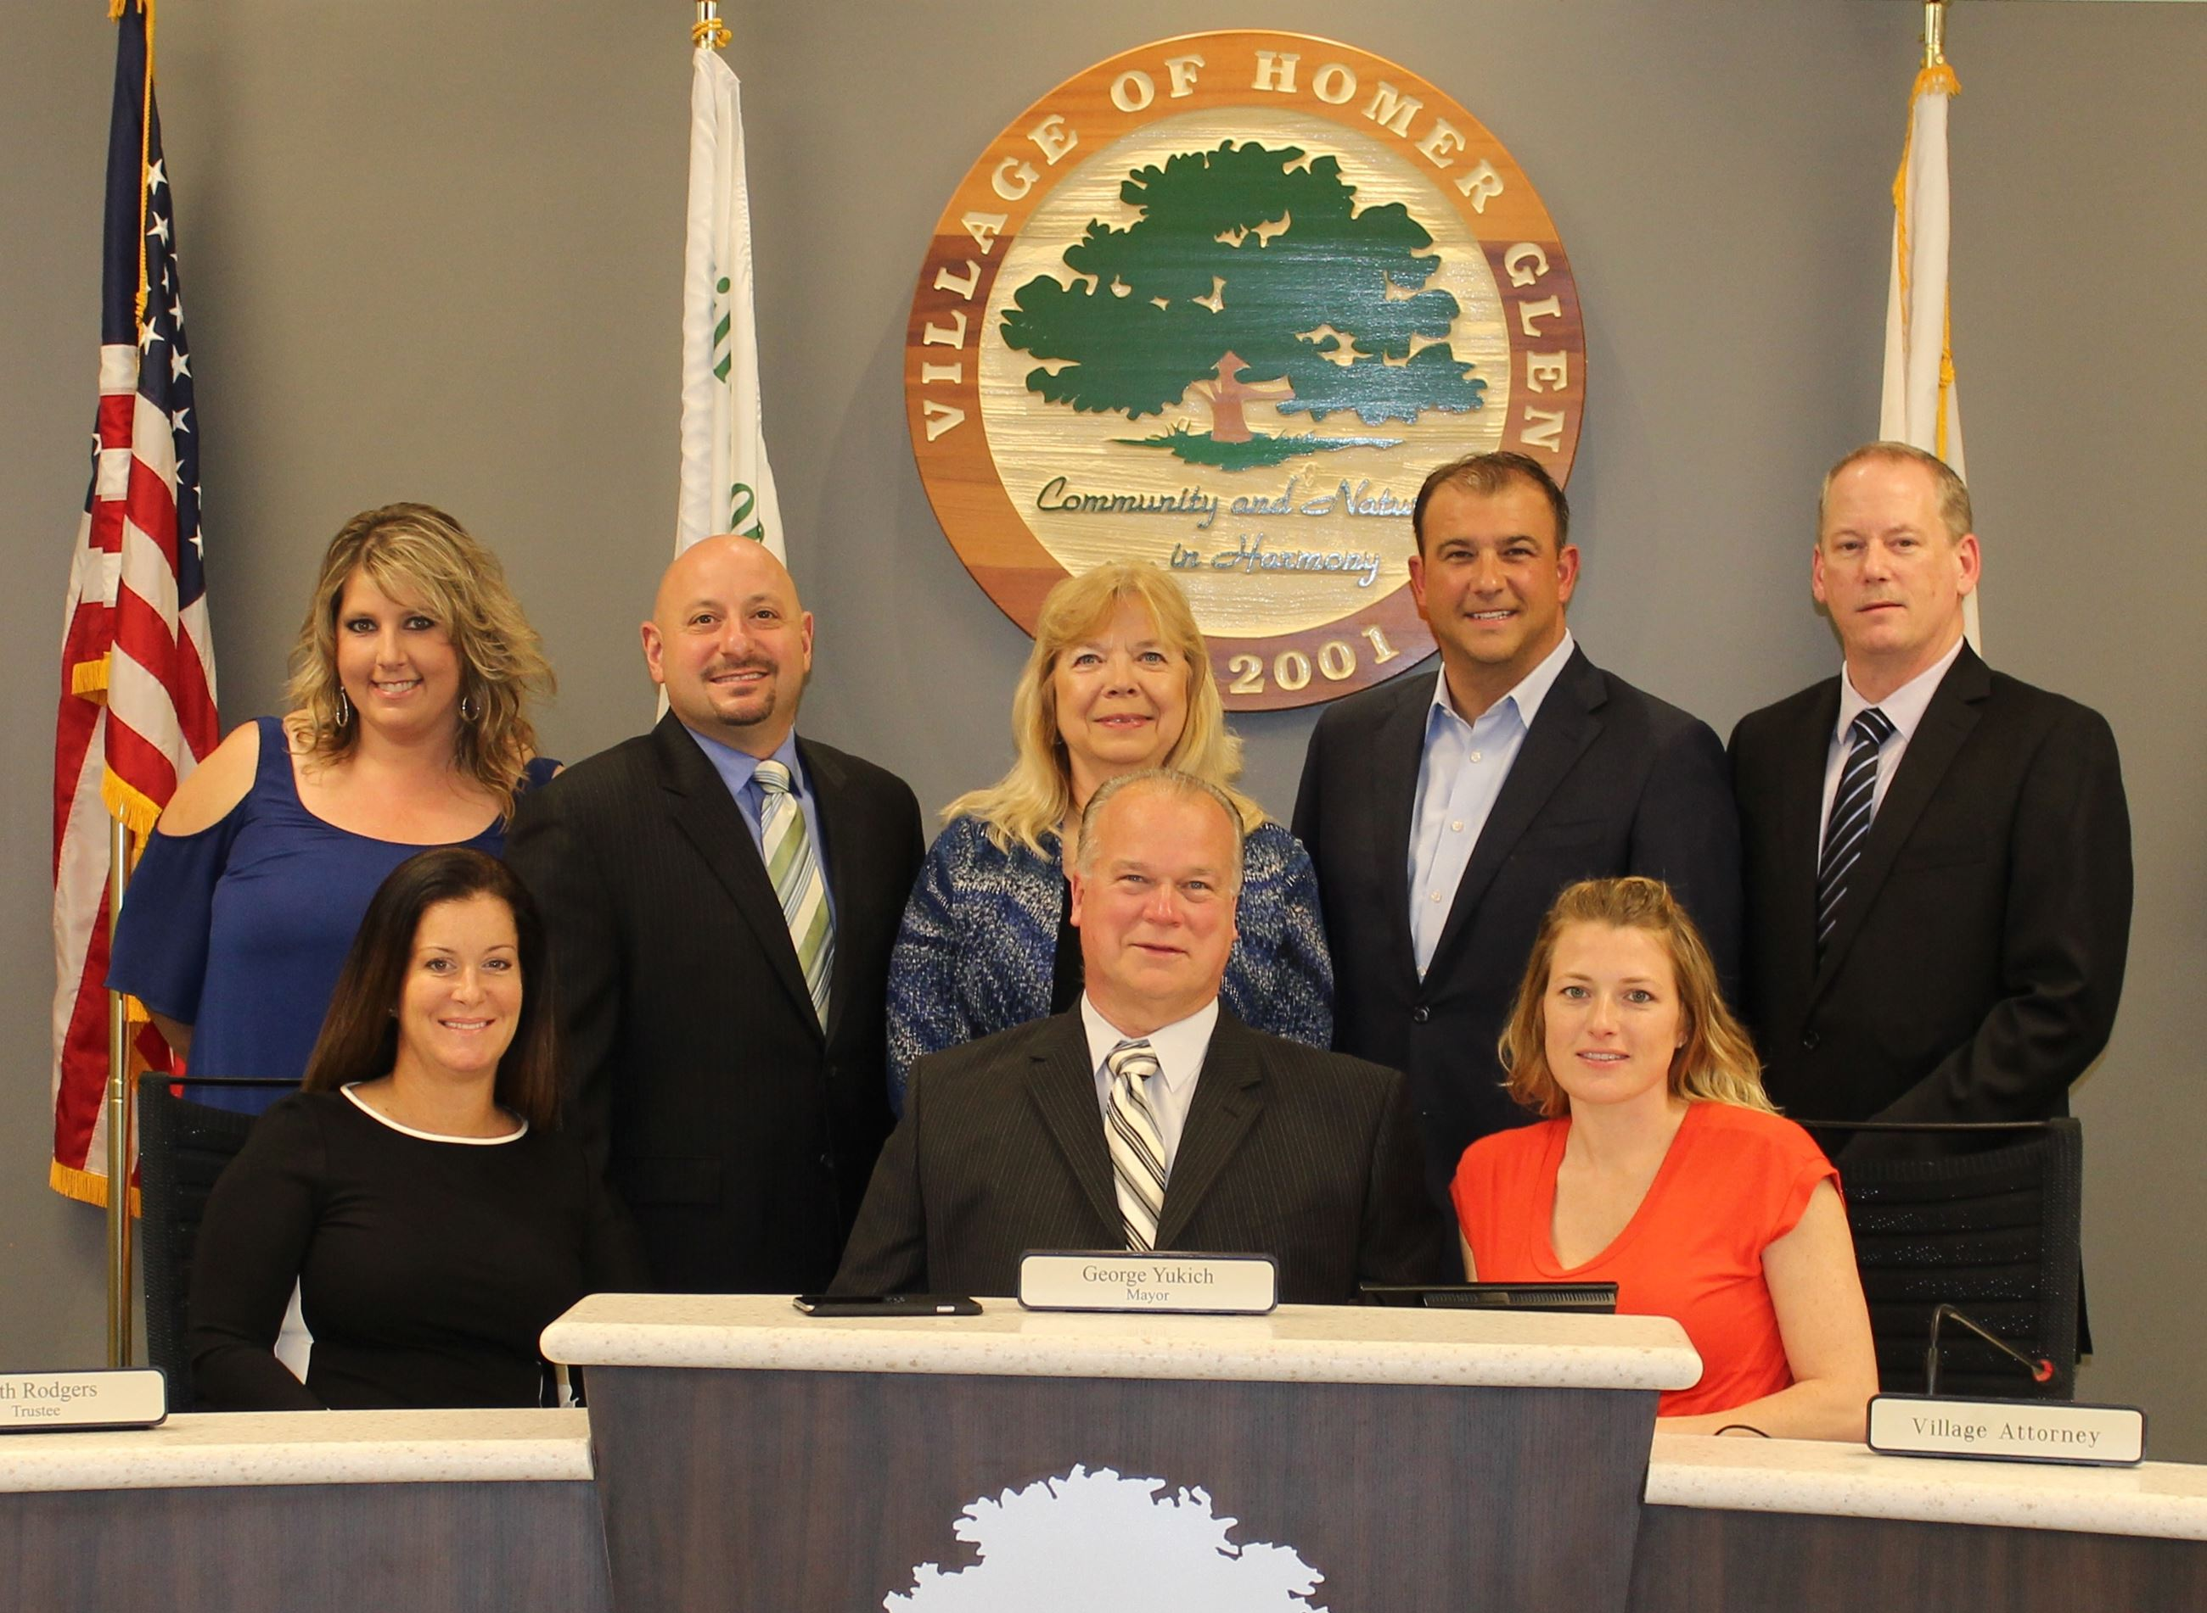
Working Together for Our Future

Slide 3
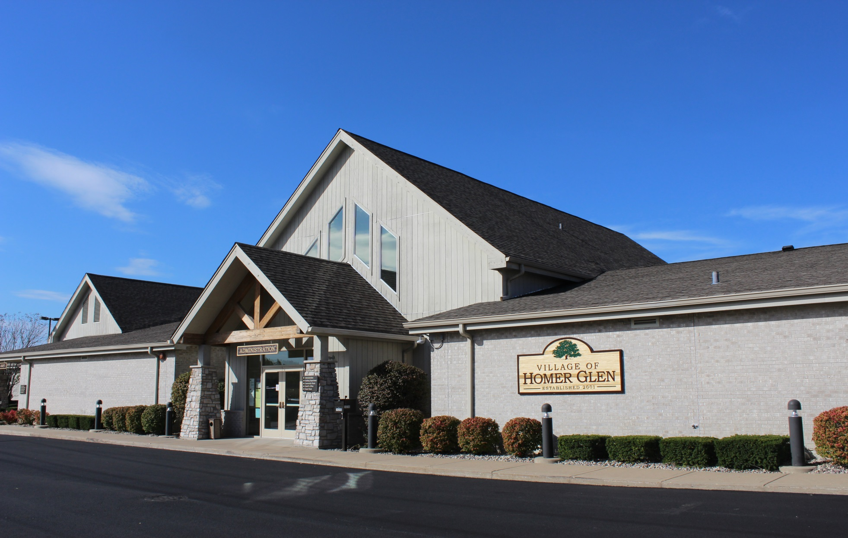
Village Hall

Slide 4
Intergovernmental Partnerships
STATE OF THE VILLAGE

Slide 5
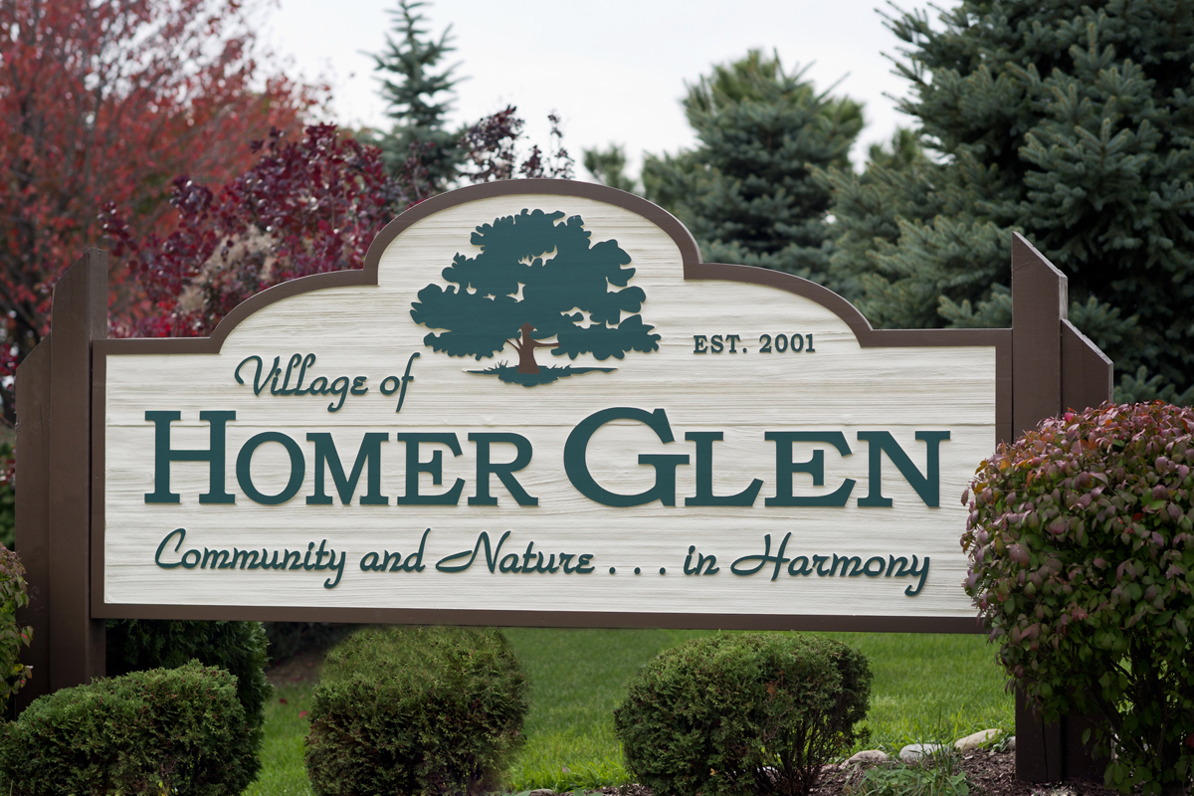
Strategic Plan
Community of Choice

Slide 6
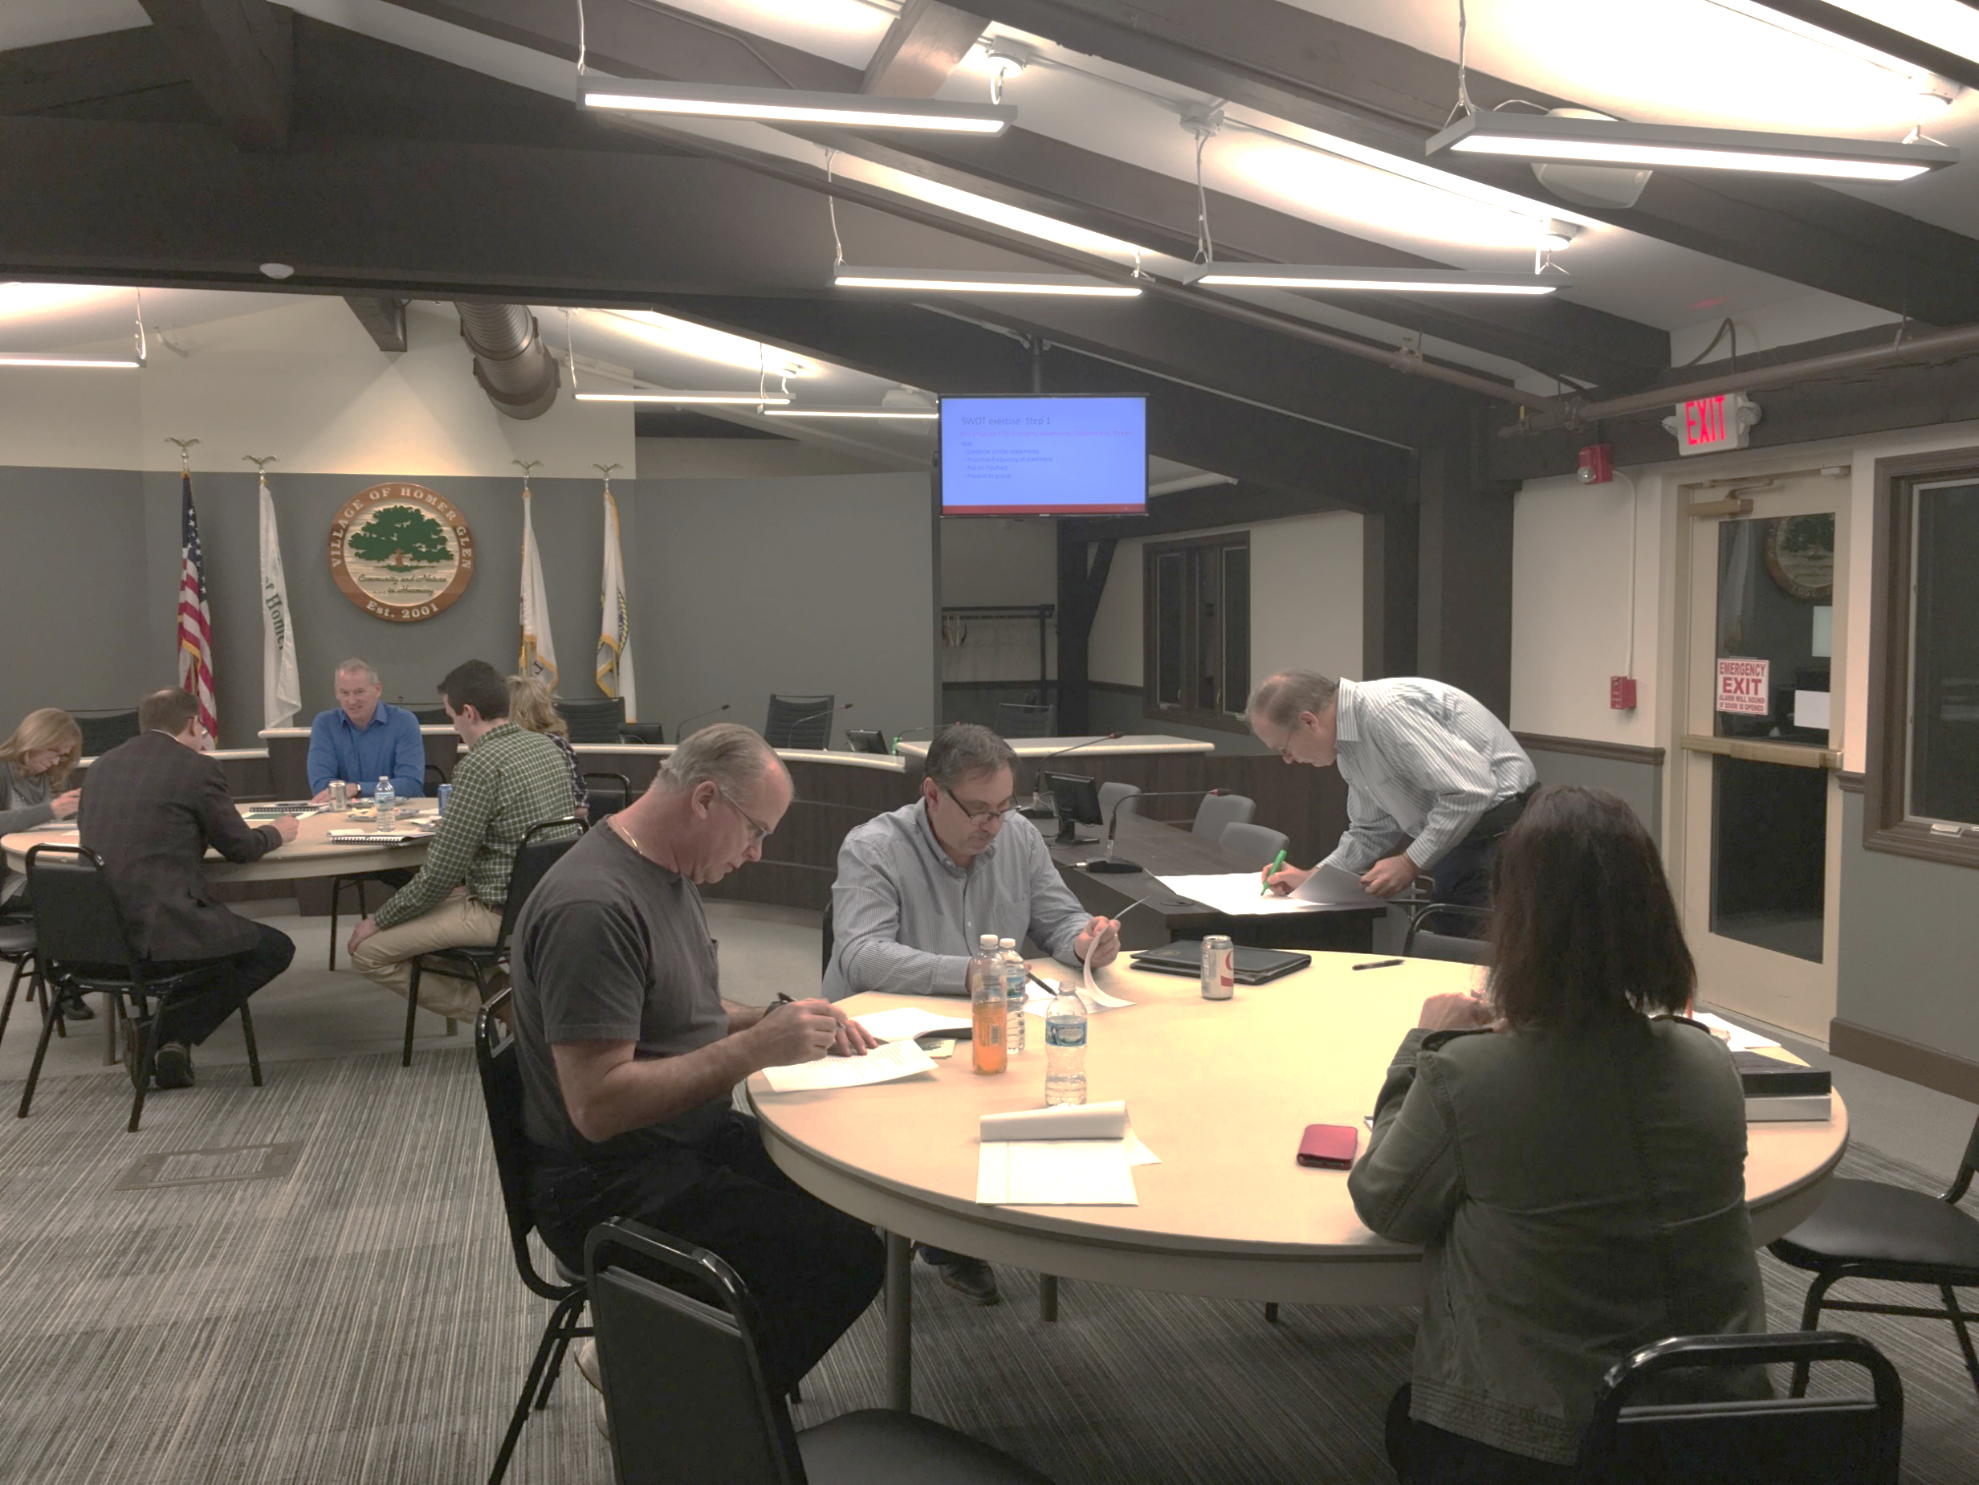
Strategic Planning Sessions
Strategic Plan

Slide 7

2018 – 2021 Strategic Priorities
INTERGOVERNMENTAL PARTNERSHIPS
INFRASTRUCTURE
FINANCIAL STABILITY
ECONOMIC DEVELOPMENT
RECREATIONAL AMENITIES
GROWTH
Strategic Plan

Slide 8
Economic Development & Growth Initiatives
Seeking clarity on the vision for major commercial corridors per market opportunities.
Evaluating gaps in water and sanitary sewer infrastructure.
Updating the Sign Regulations.
Strategic Plan

Slide 9
Economic Development & Growth Initiatives
Deliverables this year:
  Sign Regulations recommendations.
  Infrastructure Gap analysis.
Deliverables next year:
  Recommendations to update the 2005 Comprehensive Plan Land Use Map for the study areas: Major corridors and primary development locations.
Strategic Plan

Slide 10
Infrastructure
STATE OF THE VILLAGE

Slide 11
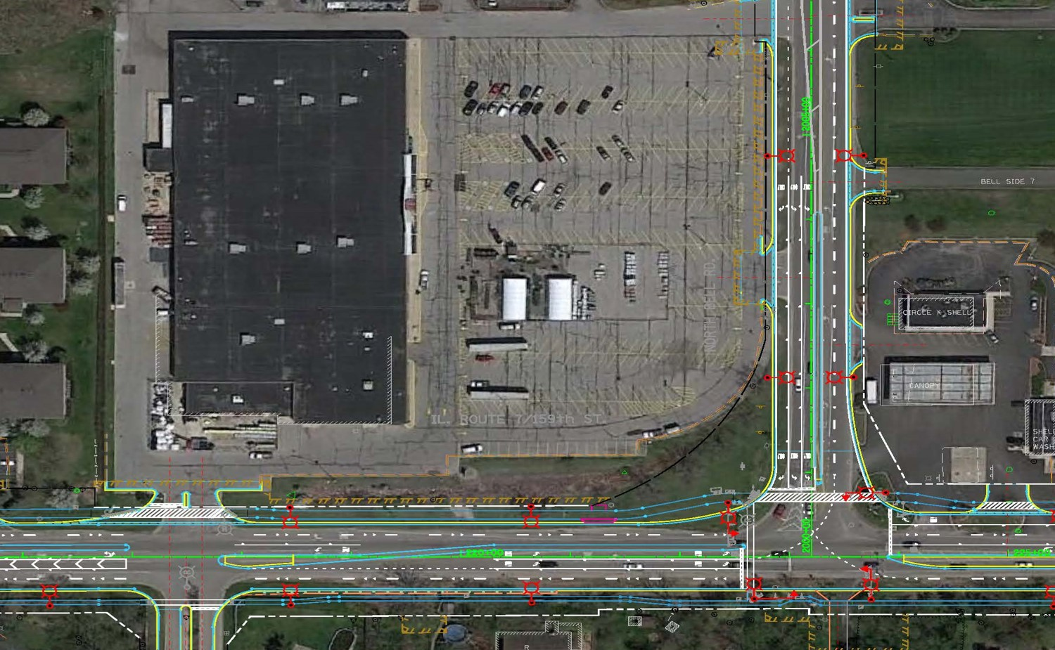
$100+ Million IDOT Project
159th Street Improvements

Slide 12
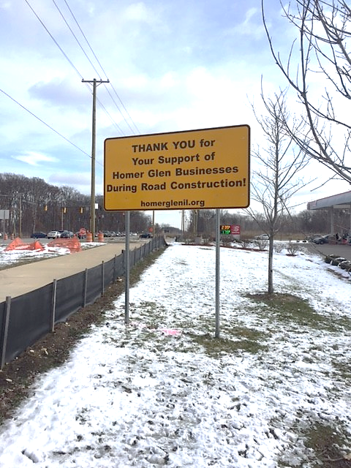
159th Street Improvements

Slide 13
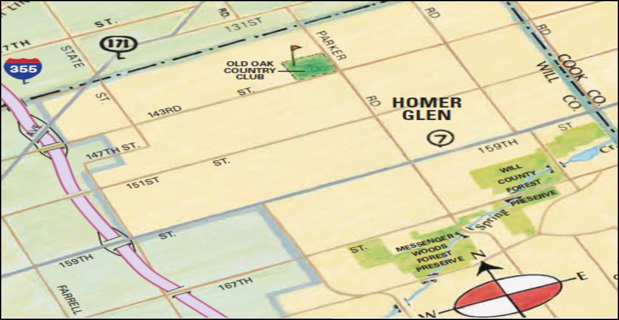
Water and Sewer Extensions to Western Border
Utilities Coverage

Slide 14
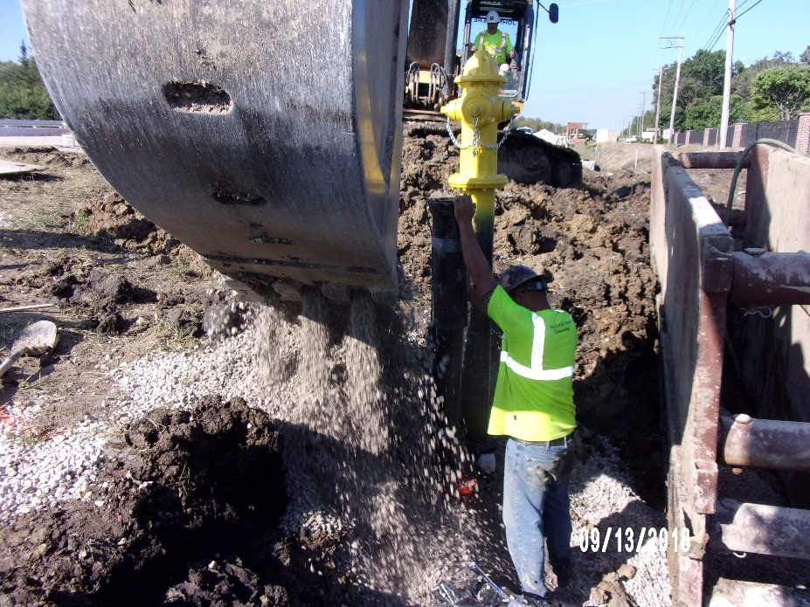
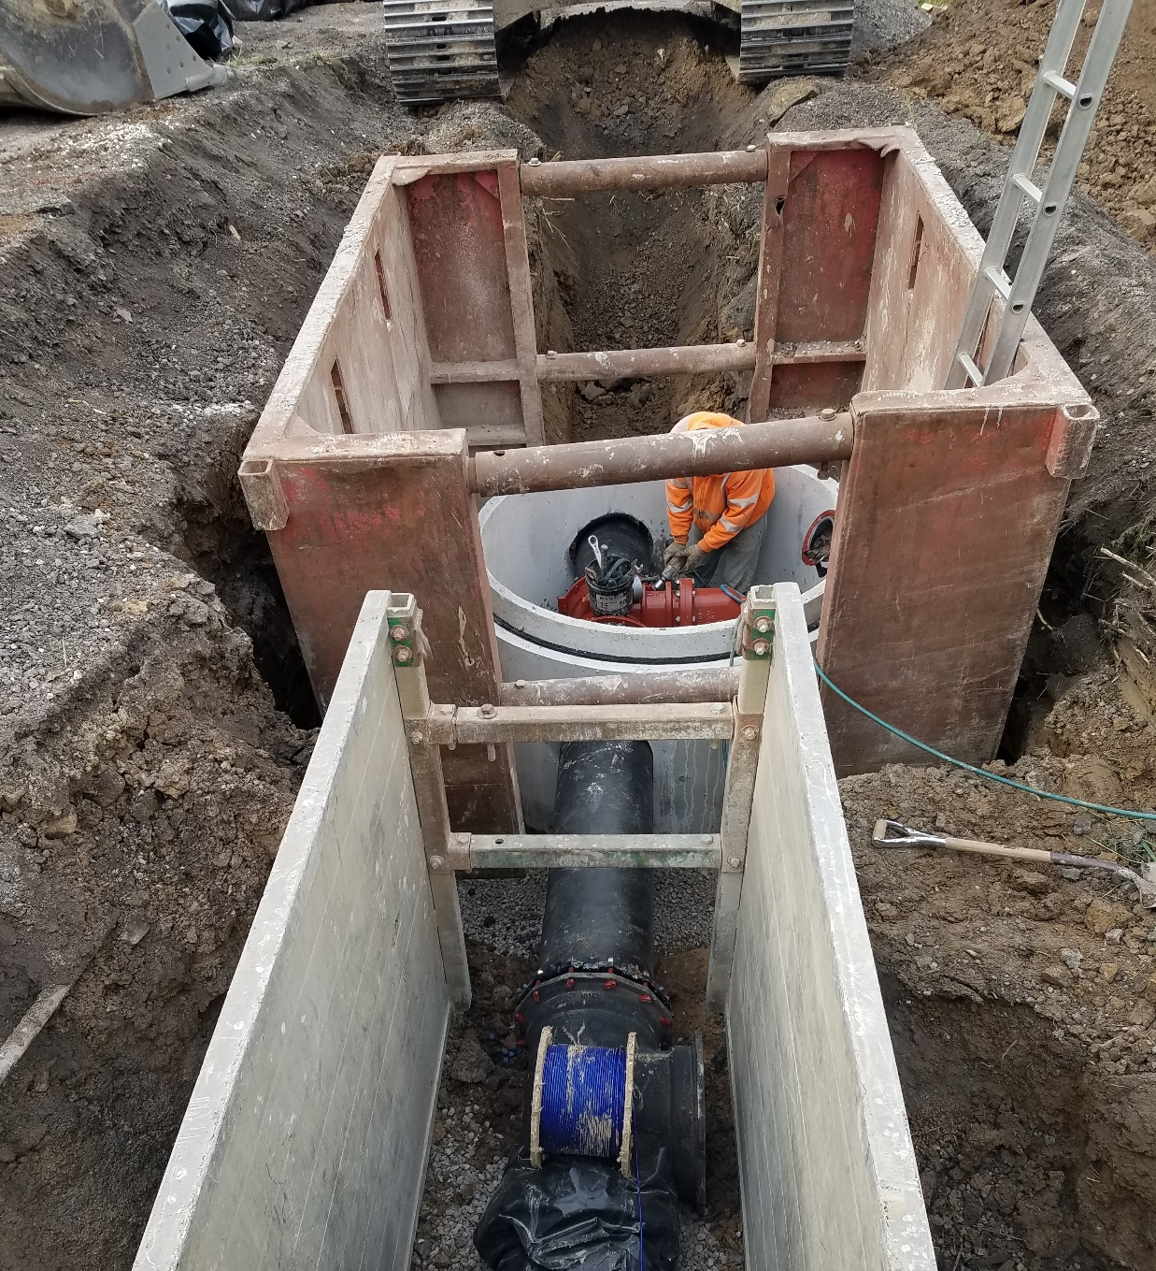
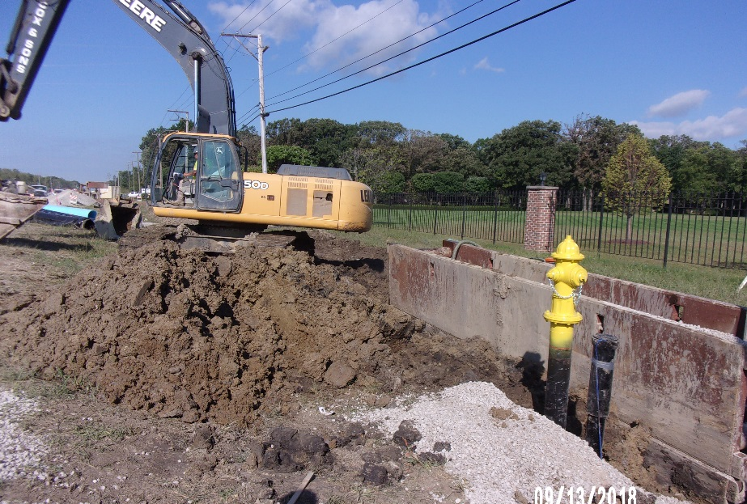
Completed
Water Main Extension

Slide 15
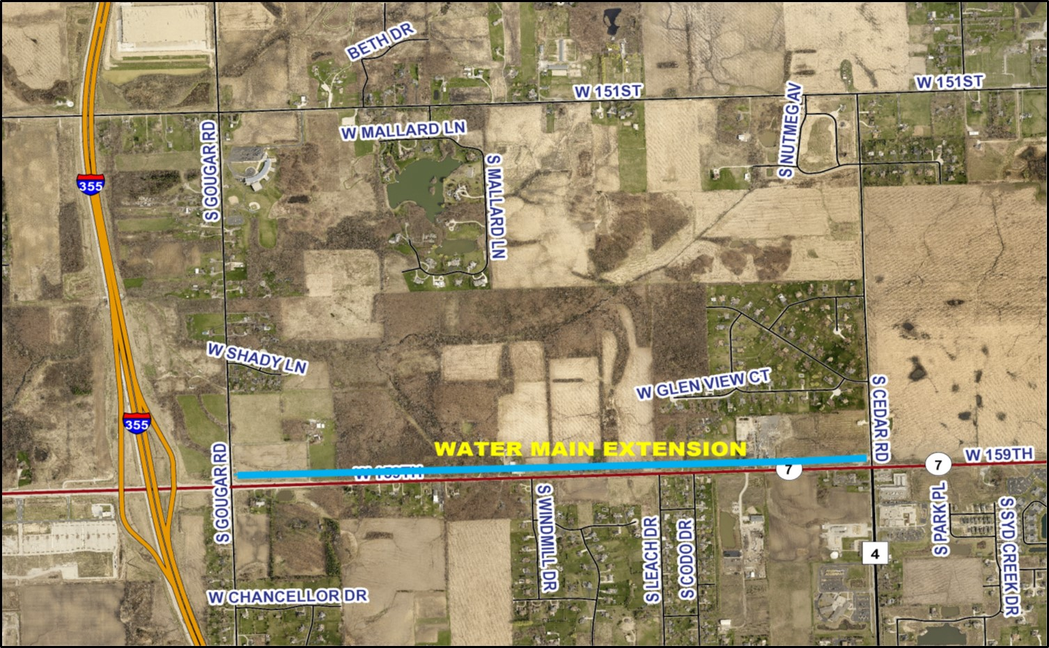
Completed
Water Main Extension

Slide 16
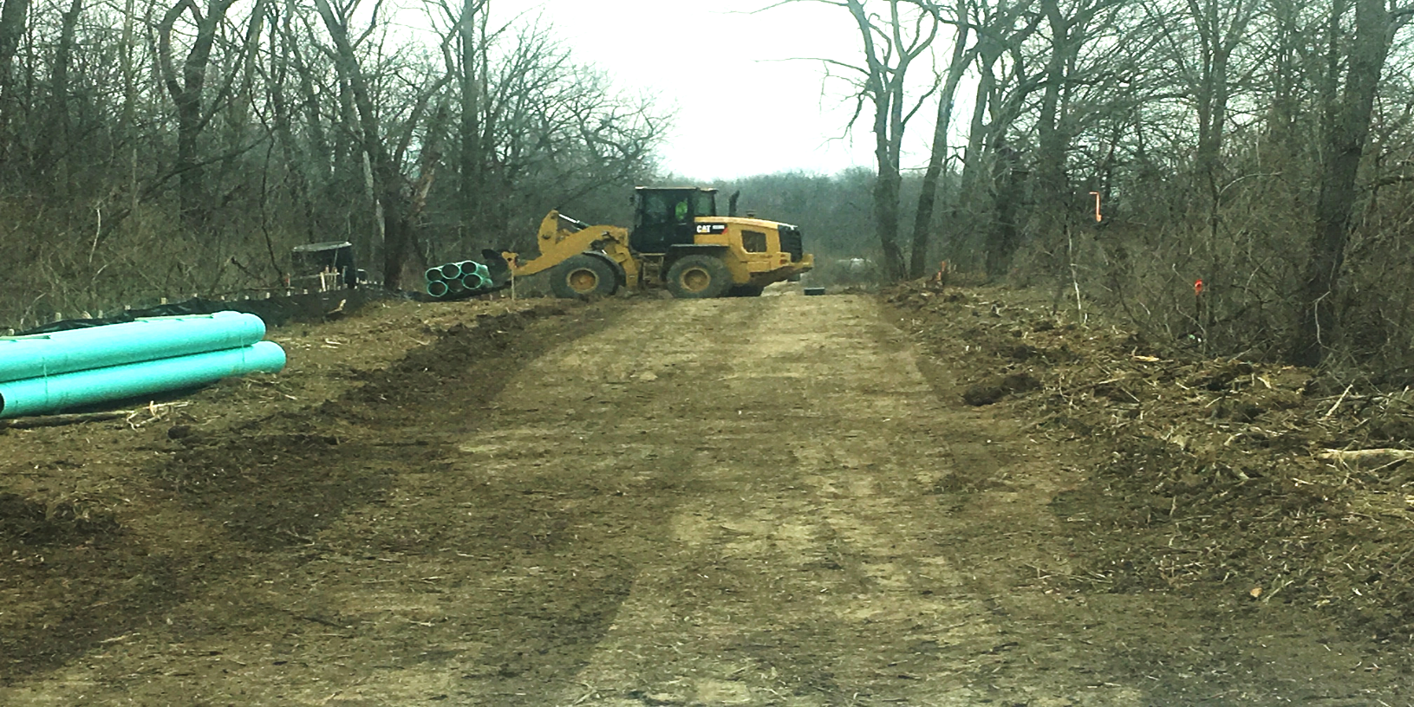
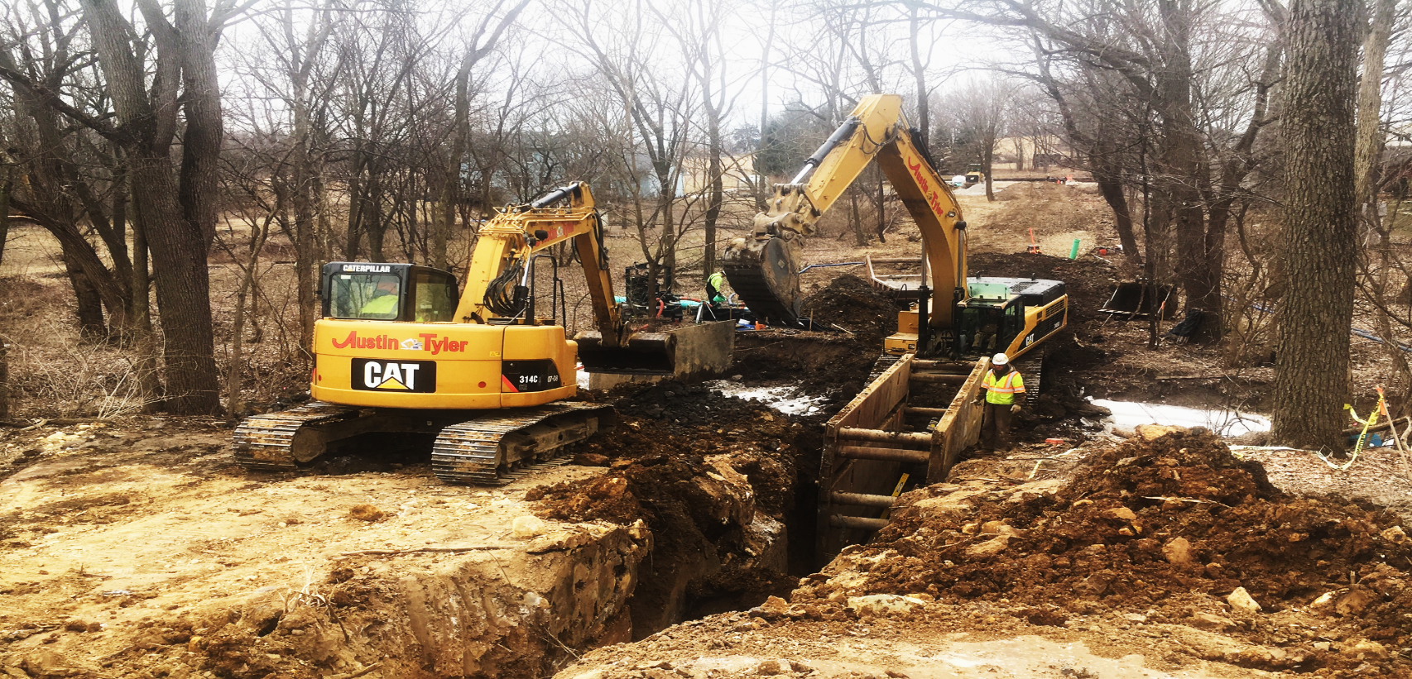
Sewer Main Extension

Slide 17
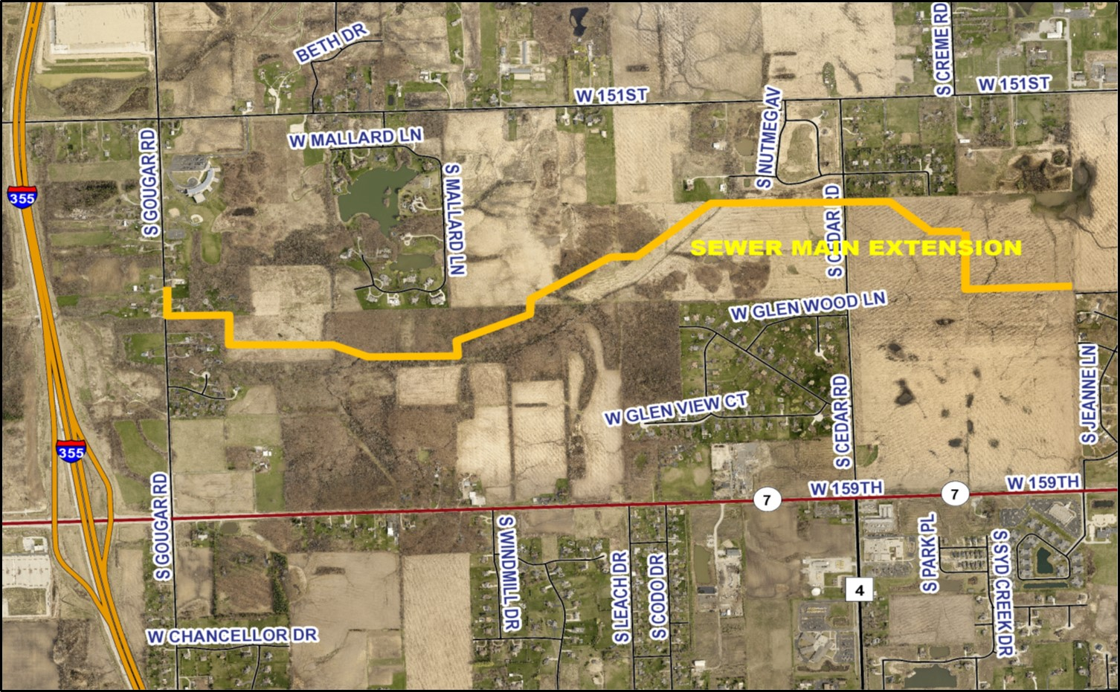
Nearing Completion
Sewer Main Extension

Slide 18
Phase 1
100% Completed
Phase 2
Nearing Completion
Sewer Main Extension

Slide 19
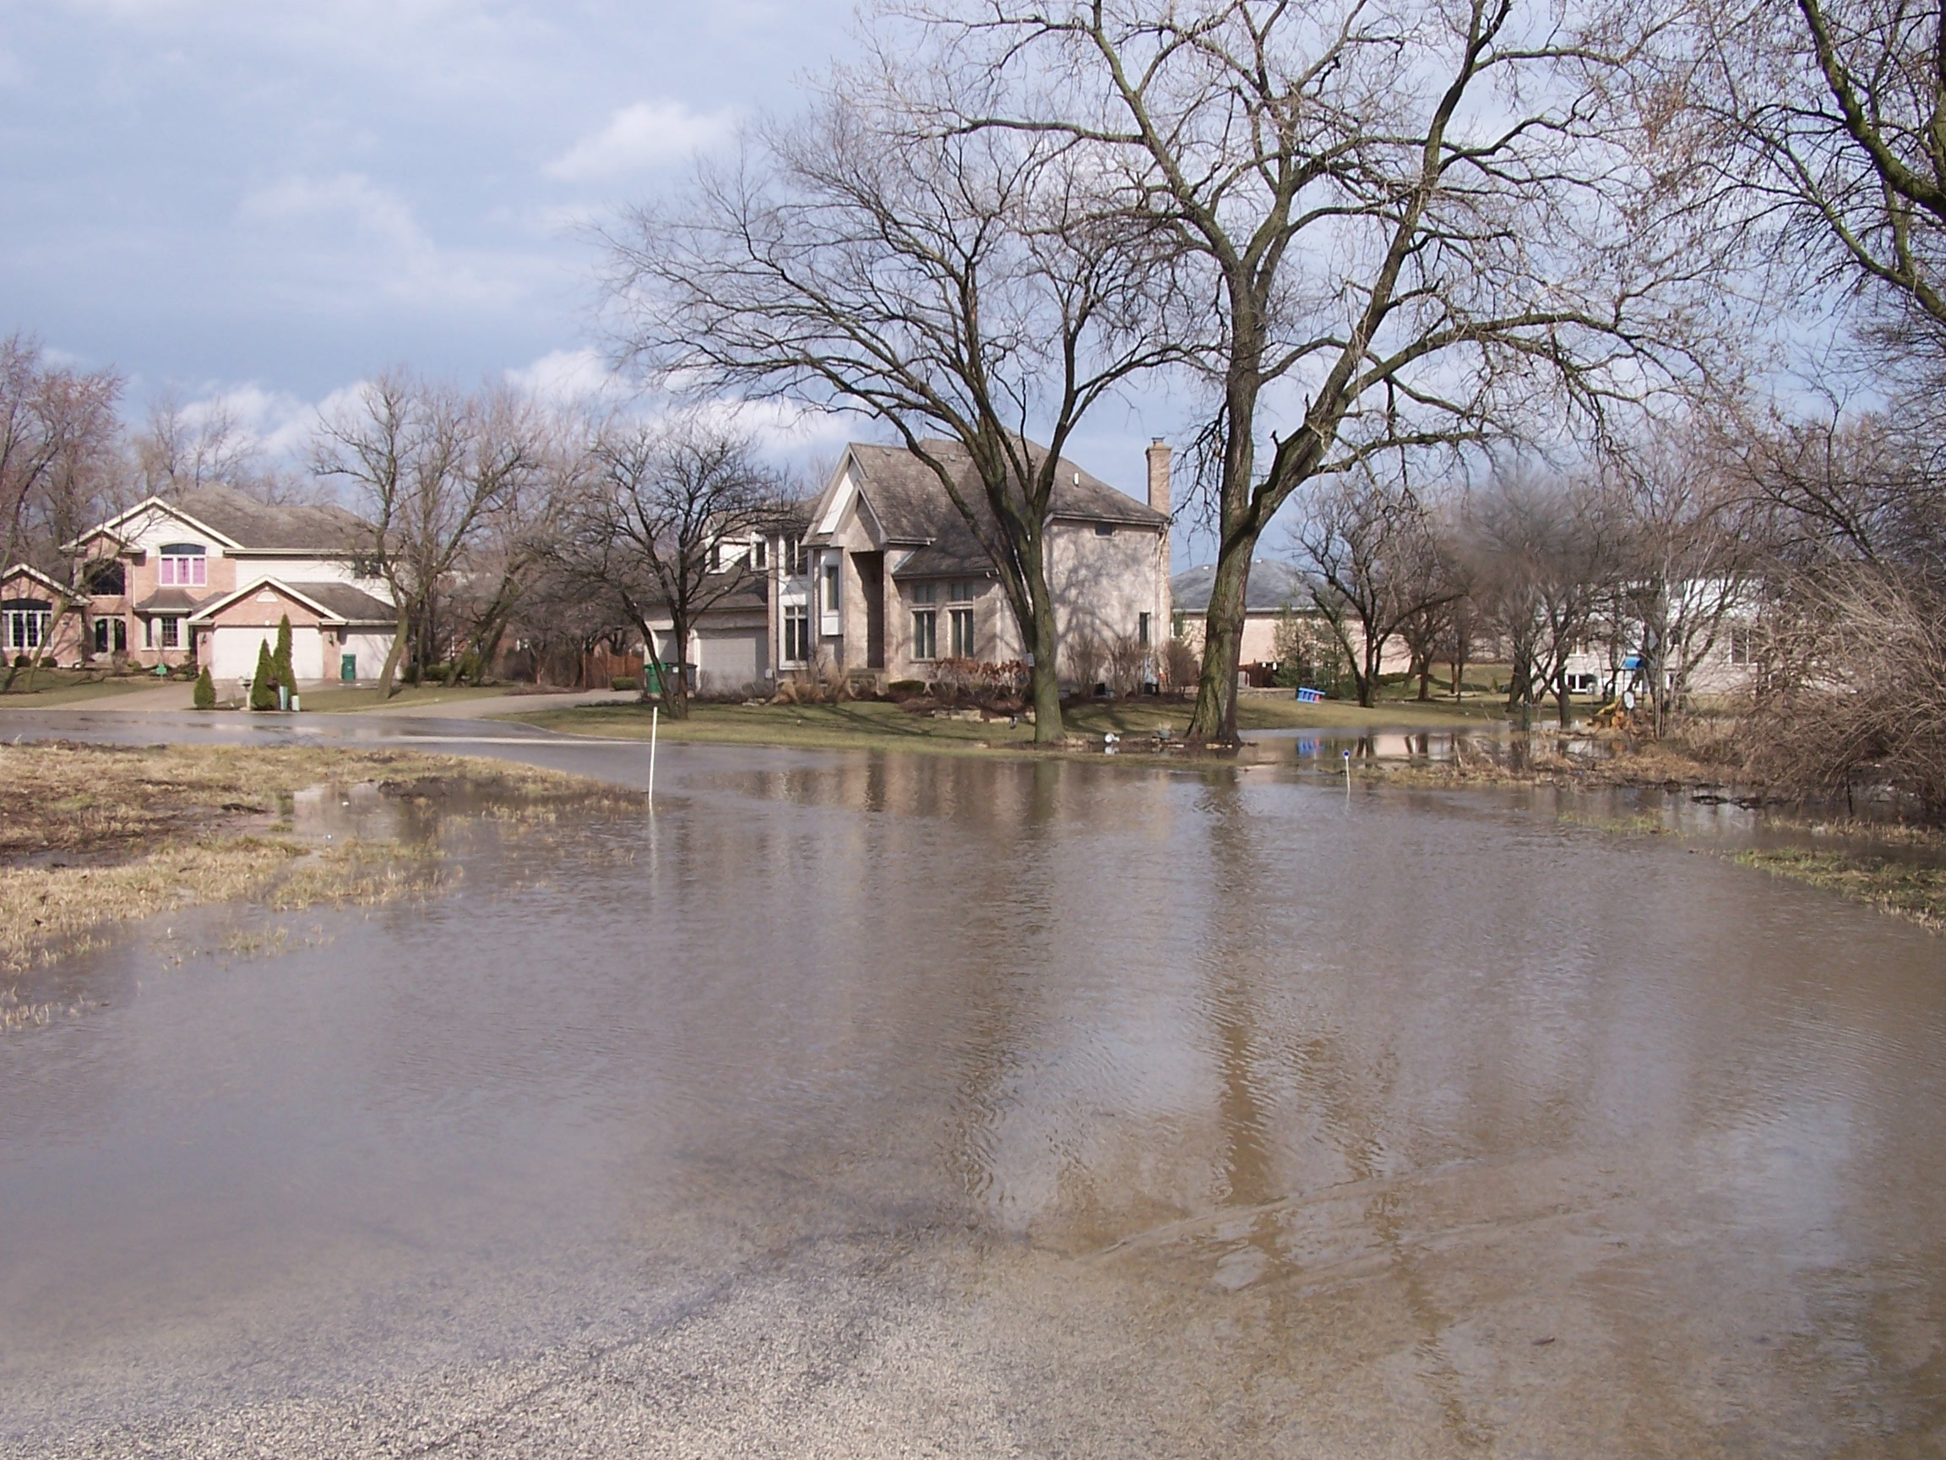
Drainage Improvement Priorities

Slide 20
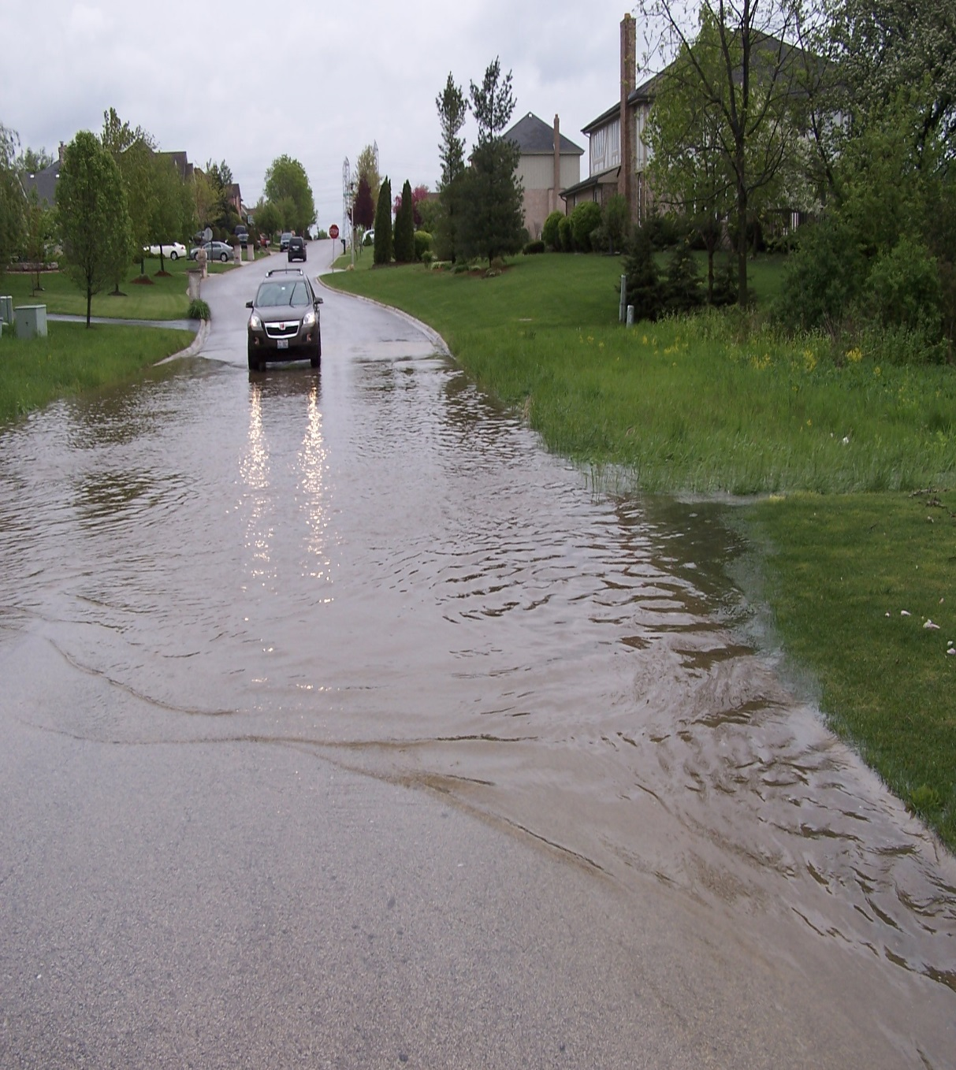
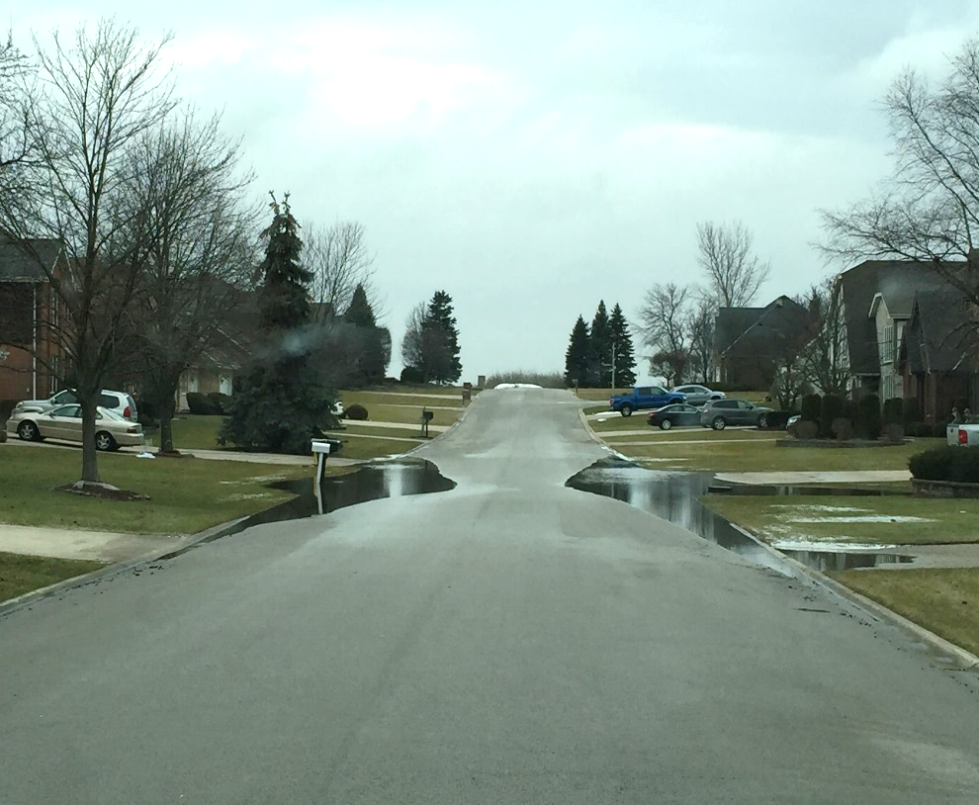
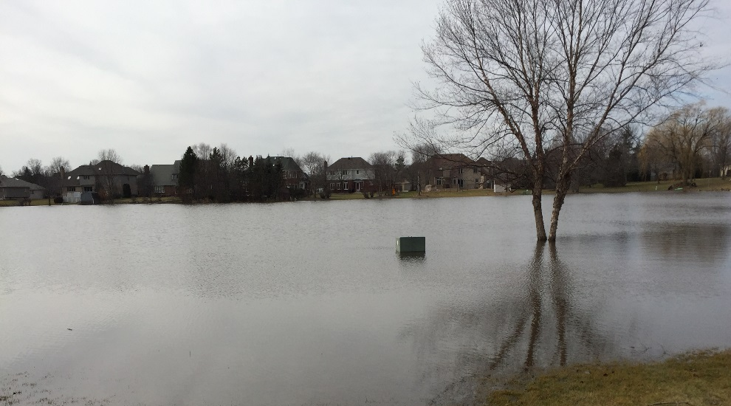
Meadowcrest
Chickasaw Hills
Drainage Improvement Priorities

Slide 21
Water Reclamation Facilities

Slide 22
Code Improvements
STATE OF THE VILLAGE

Slide 23
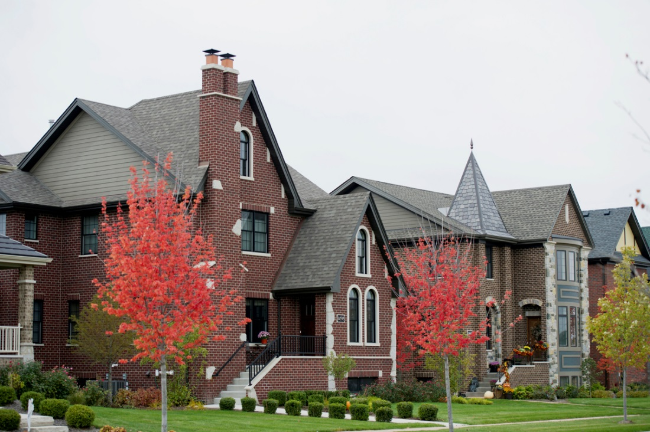
Residential Development Impact Fees
35% REDUCTION
Code Improvements

Slide 24
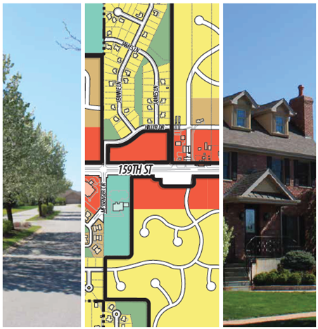
Land Use and Site Development Regulations Consolidated
Code Improvements

Slide 25

Building Code Update
Code Improvements

Slide 26
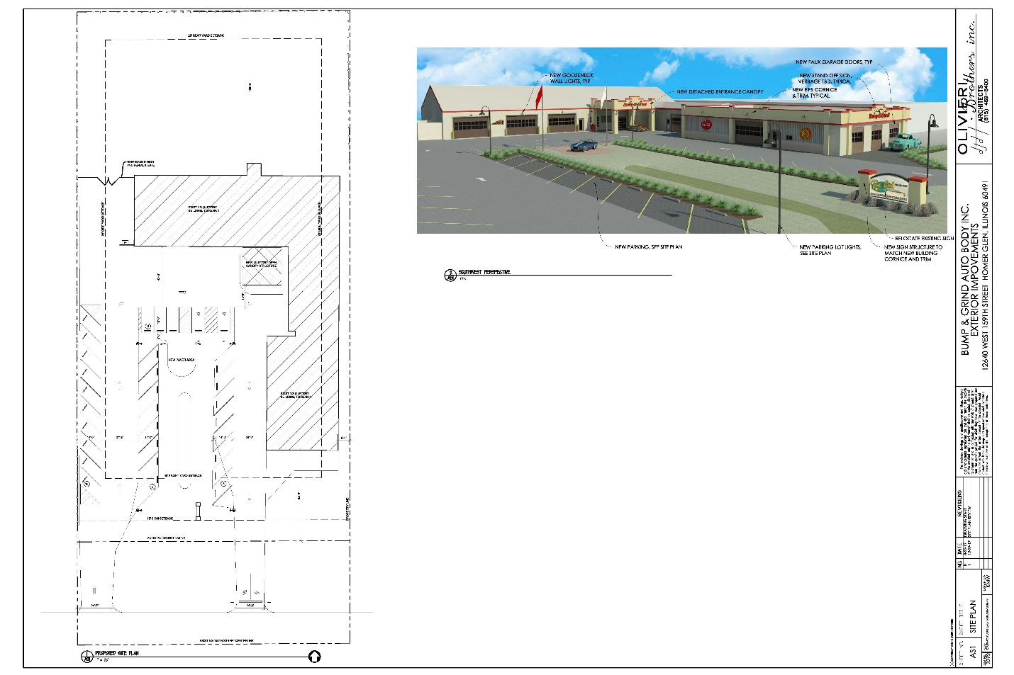
PUD Process Streamlined
Code Improvements

Slide 27
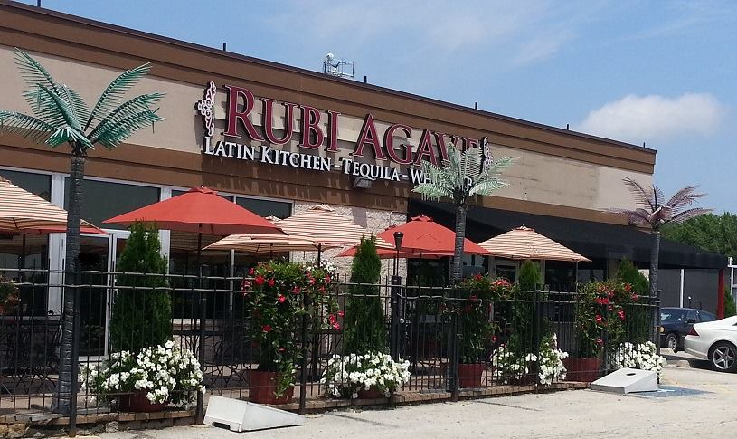
Outdoor Seating & Liquor Sales Streamlined
Code Improvements

Slide 28
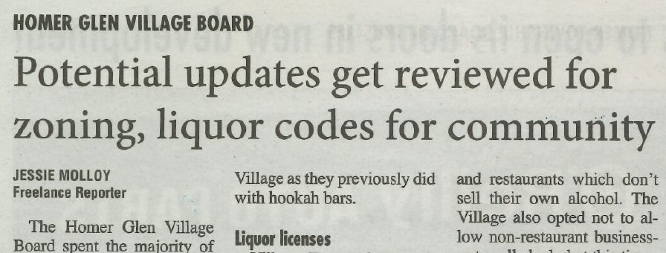
Proposed Update to the Use Table
(Non-Residential Districts)
Code Improvements

Slide 29
Proposed Update to Liquor Classifications
  Enable business owners to remain competitive.
  Expand business recruitment opportunities to further diversify retail venues and generate new retail sales tax.
Code Improvements

Slide 30
Financial Stability
STATE OF THE VILLAGE

Slide 31
Better than anticipated revenues led by:
  Increased Sales Tax Revenue
  Building Permits
  Development Revenue
Financial Stability

Slide 32
Sales Tax Revenue Growth

Slide 33

Sales Tax Revenue up 2.1% over
previous year
Sales Tax Revenue Growth

Slide 34

Operating Surplus of $420,000 projected for FY 2020
Financial Stability

Slide 35
FY 2020 Budget
No Fee Increases
No Municipal Property Tax
Financial Stability

Slide 36

$200,000 Cost Savings
Public Safety Services
Financial Stability

Slide 37
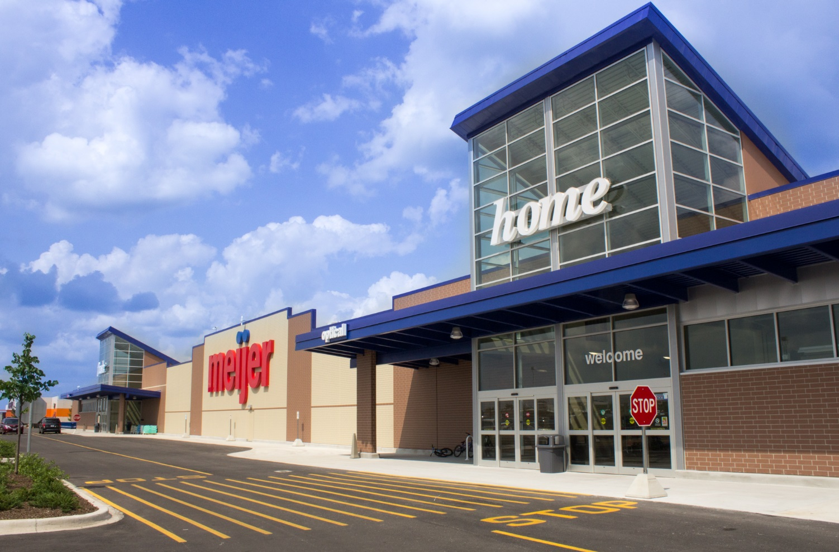
100% Retention of
Sales Tax Revenue
Coming in FY 2021
Financial Stability

Slide 38
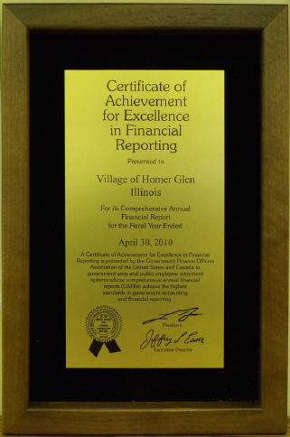
AWARD WINNING!
Financial Stability

Slide 39
STANDARD & POORS
BOND RATING
AA+
“Strong capacity to meet
all financial commitments.”
Financial Stability

Slide 40
Economic
Development
STATE OF THE VILLAGE

Slide 41
46 New Single Family Homes
in 2018
259 New Home Permits
0ver the Last 5 Years
Growth

Slide 42
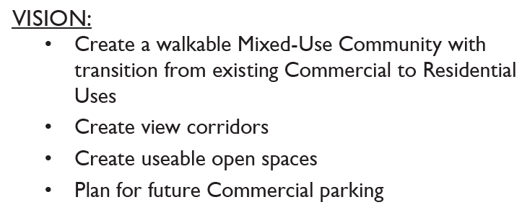
The Square at Goodings Grove
A walkable mixed-use community with 76 Townhomes and 3.9 acres of commercial frontage.
Growth

Slide 43
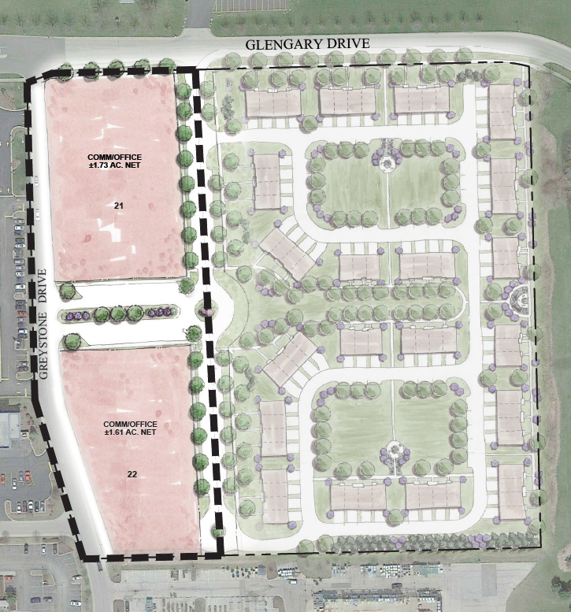
Approved Site Plan
The Square At Goodings Grove

Slide 44
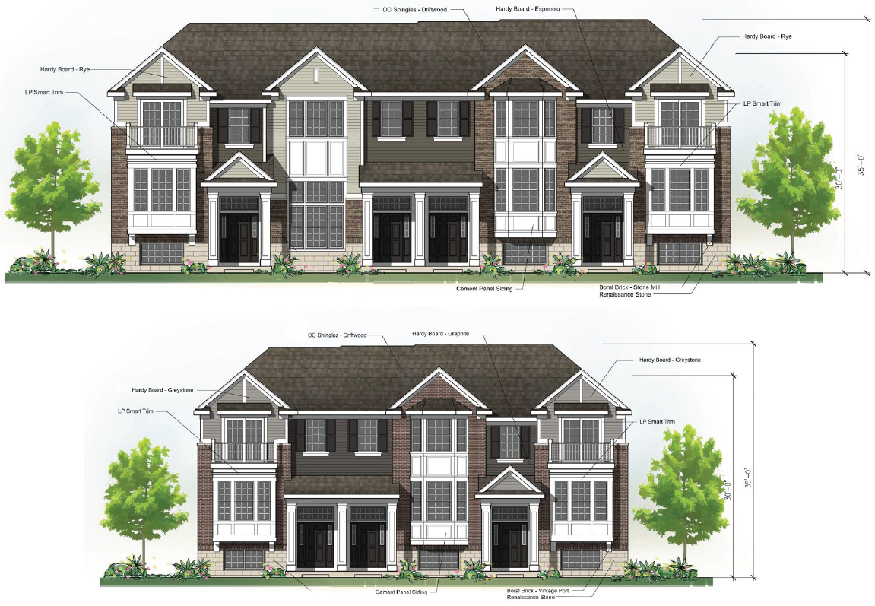
Approved Townhomes
The Square At Goodings Grove

Slide 45
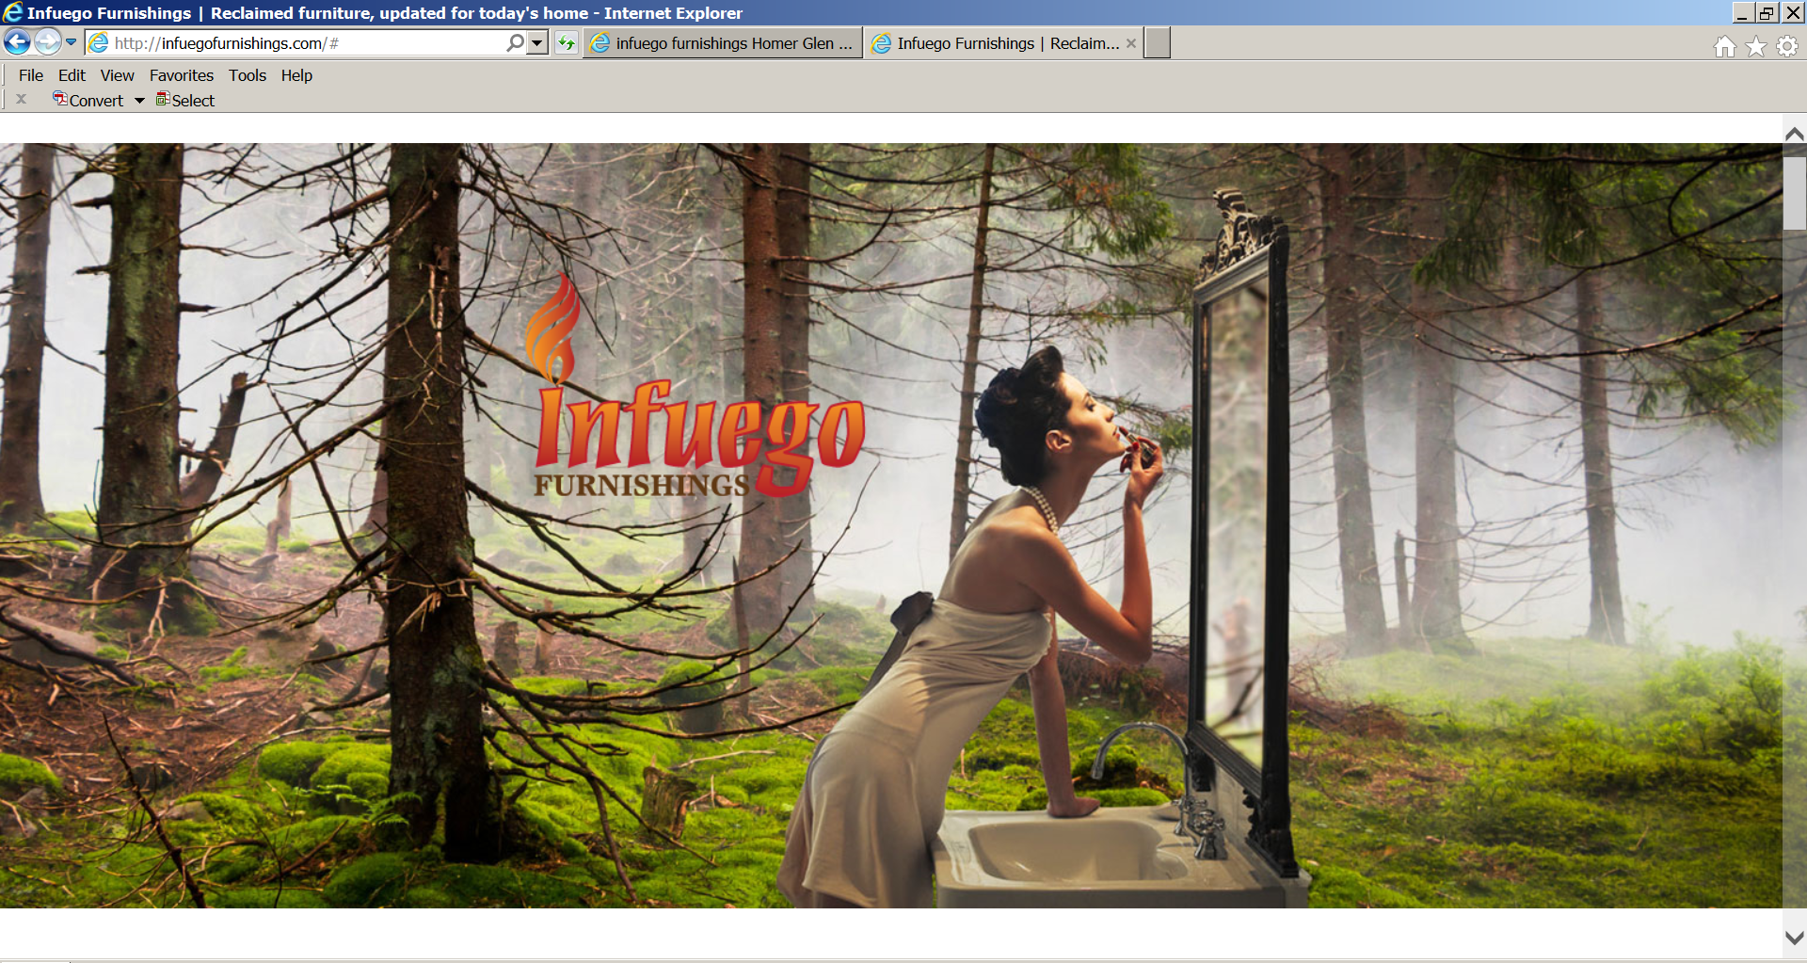
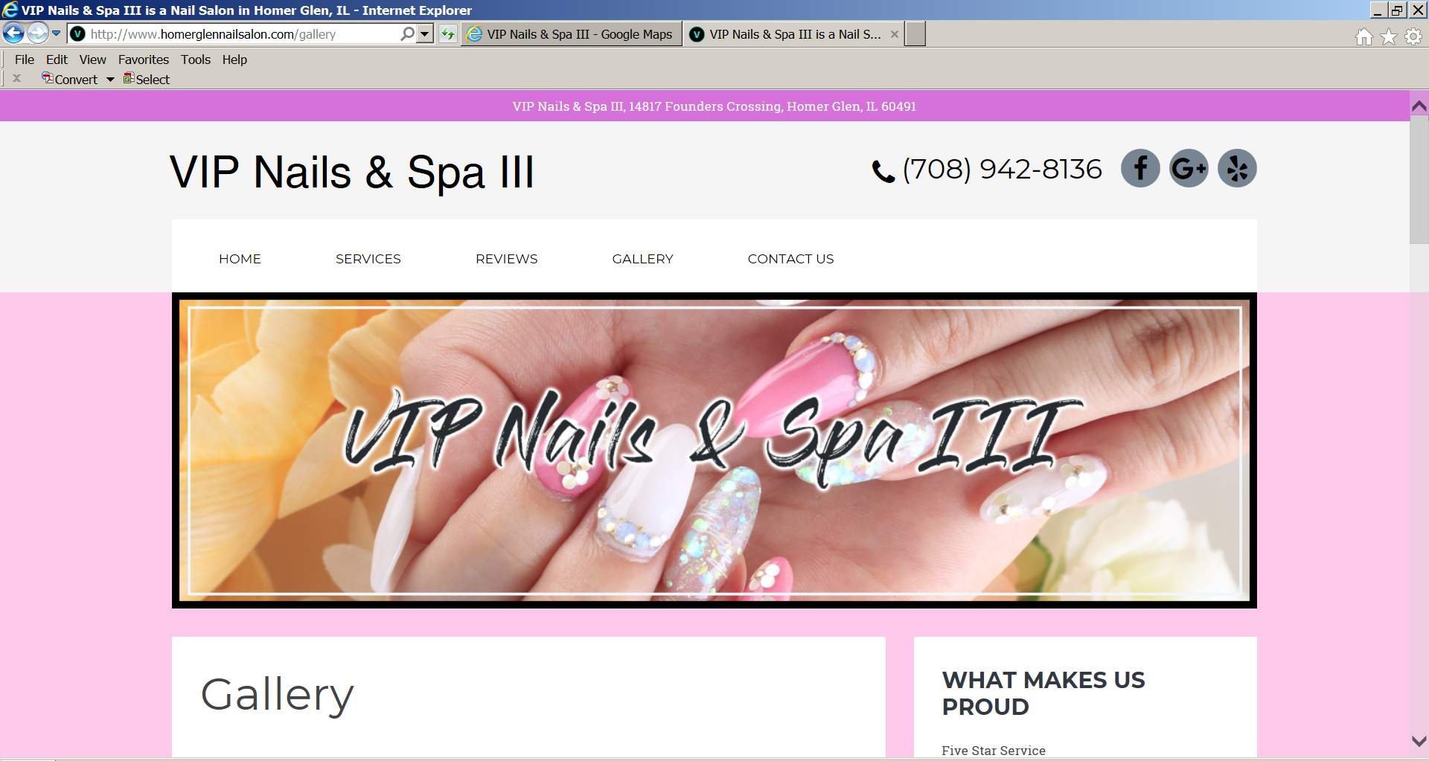
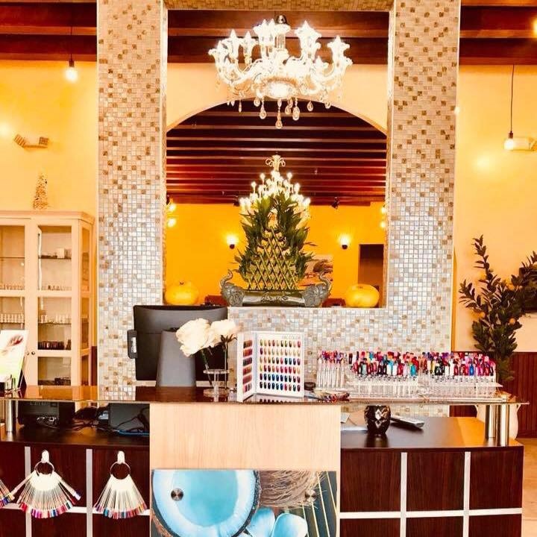
Vintage Furnishings Modernized
and Repurposed for Today’s Lifestyles
Economic Development

Slide 46

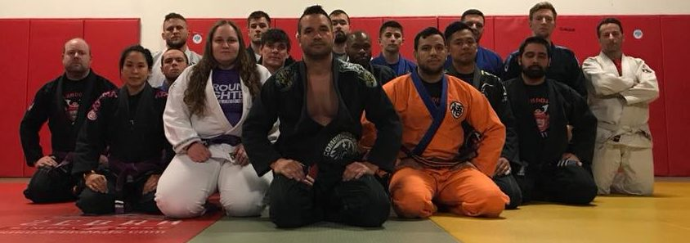
Randori Jiu Jitsu
Economic Development

Slide 47
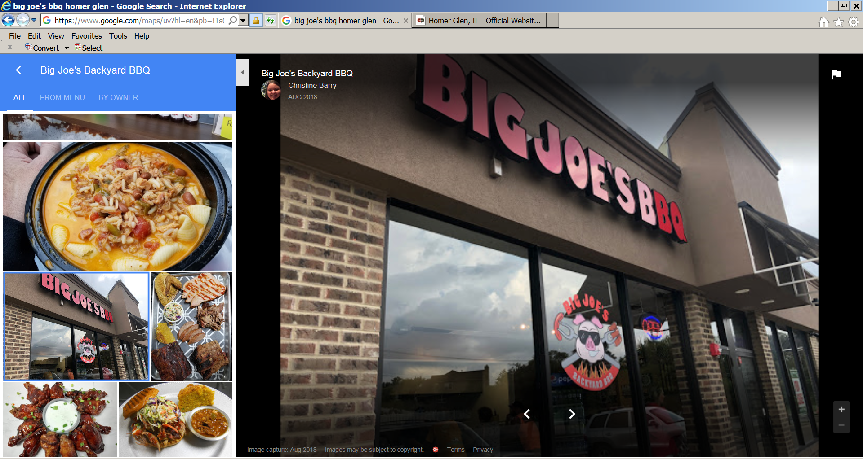

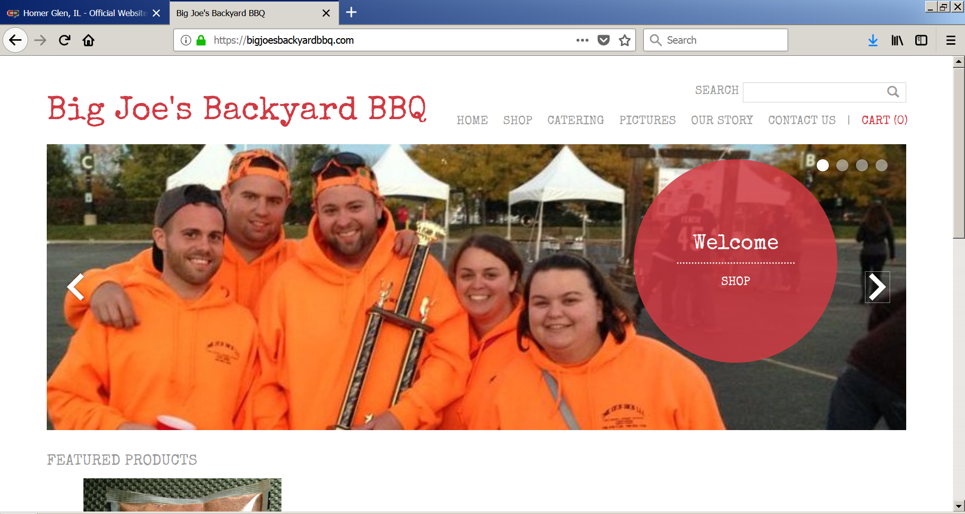
Slow-Smoked BBQ
and Homemade Sides
Economic Development

Slide 48
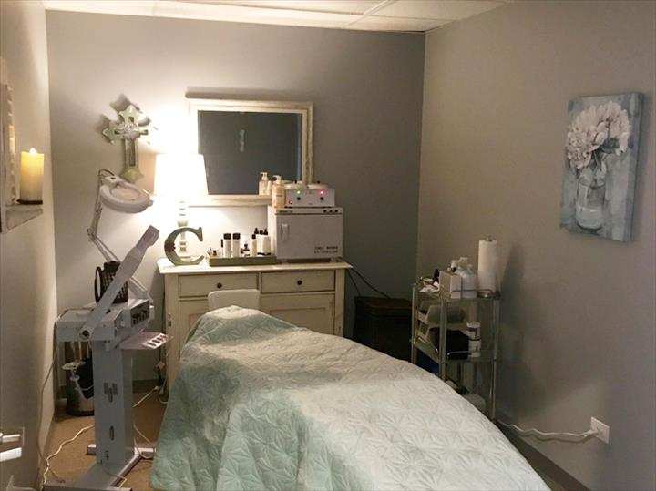


Bella Body
Med Spa
Economic Development

Slide 49
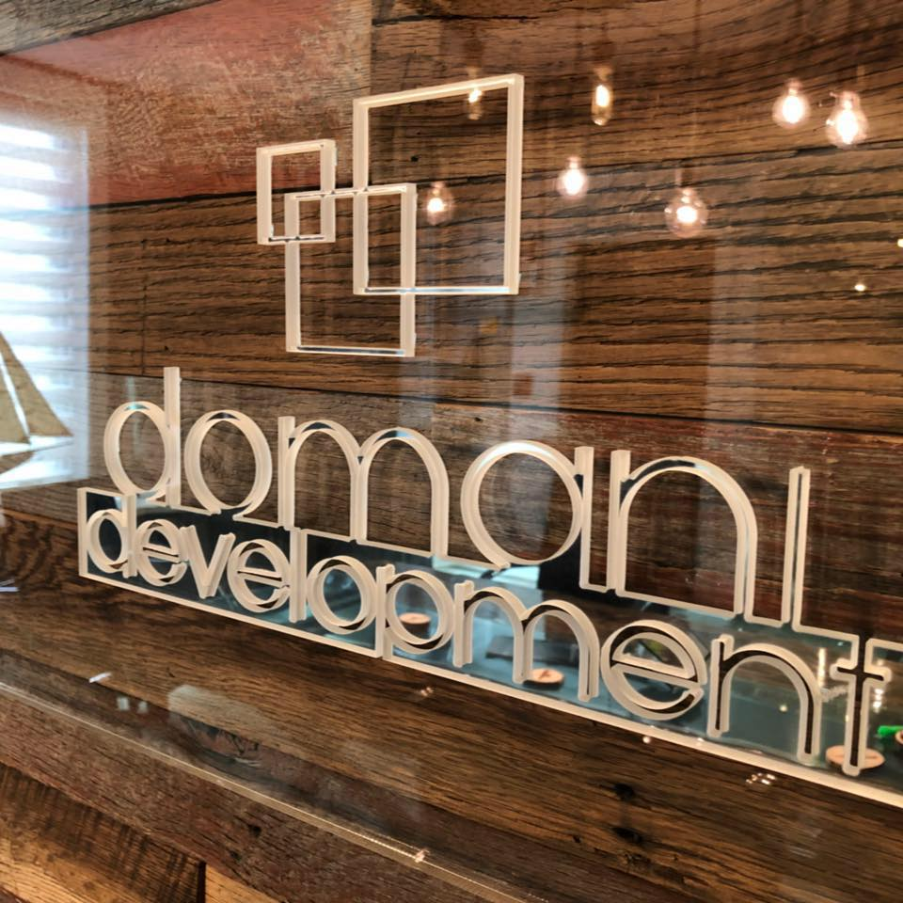
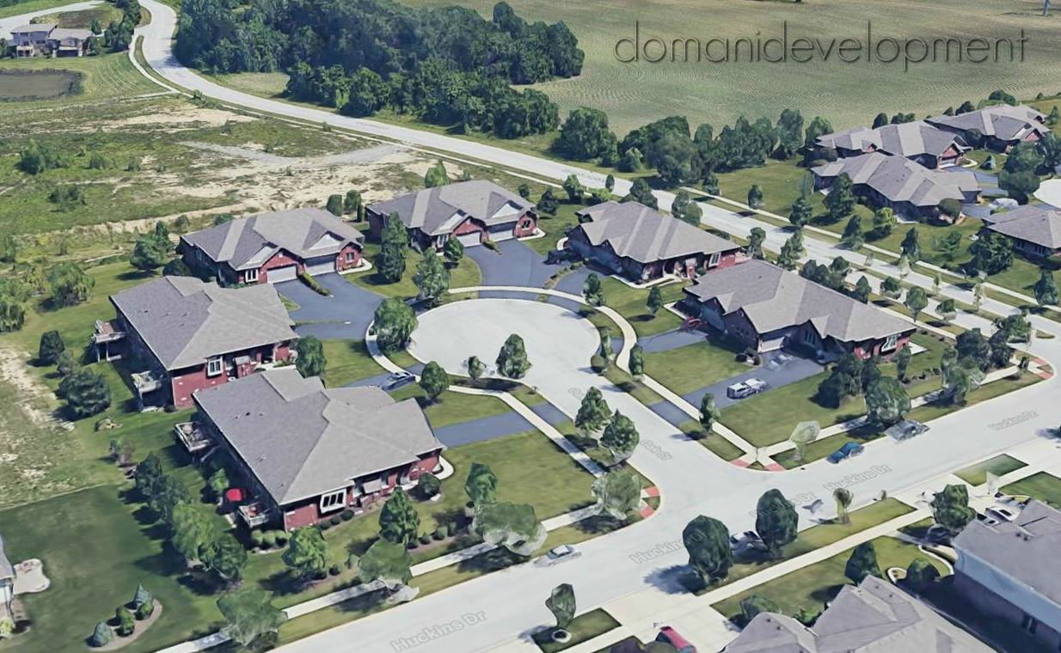
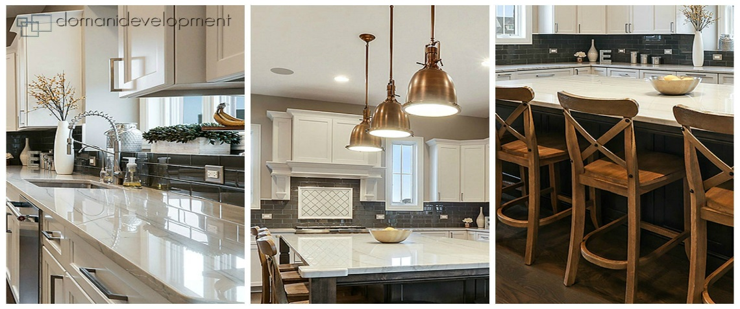
Remodelers. Builders. Developers.
Economic Development

Slide 50
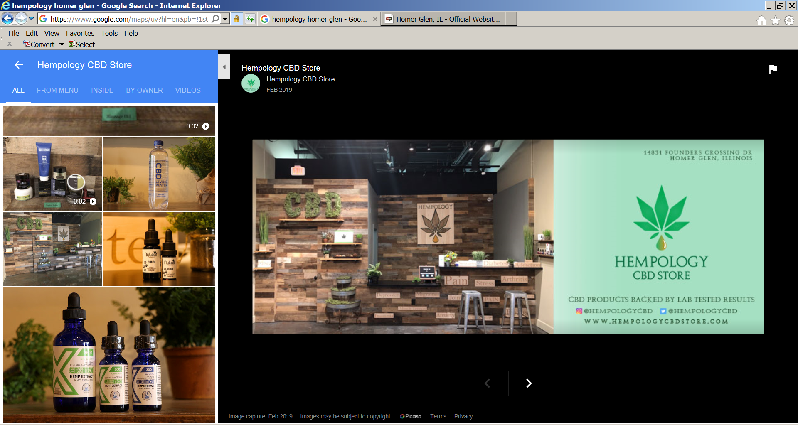
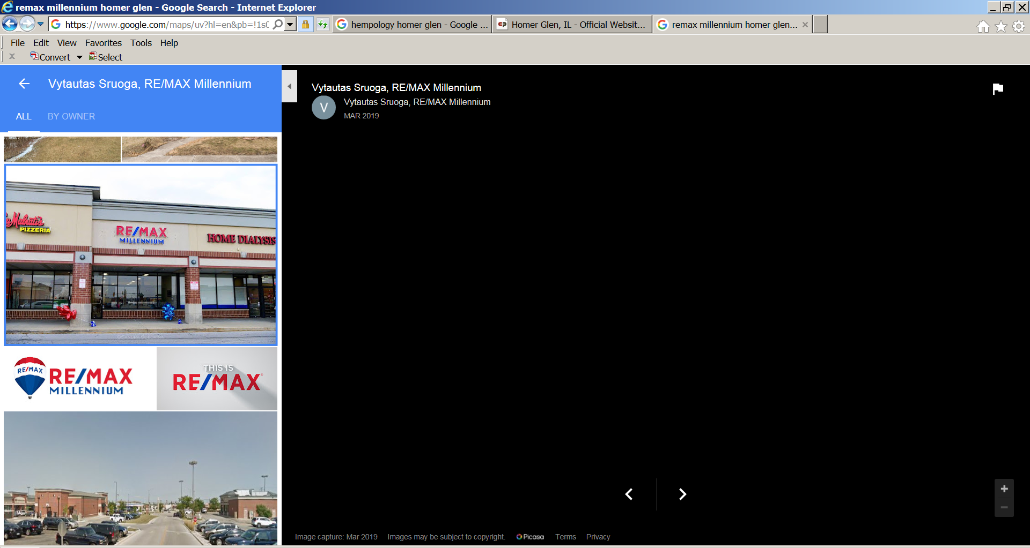
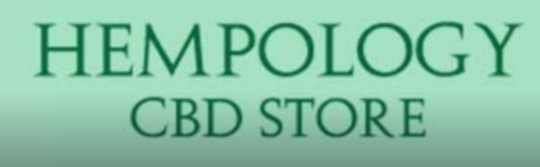
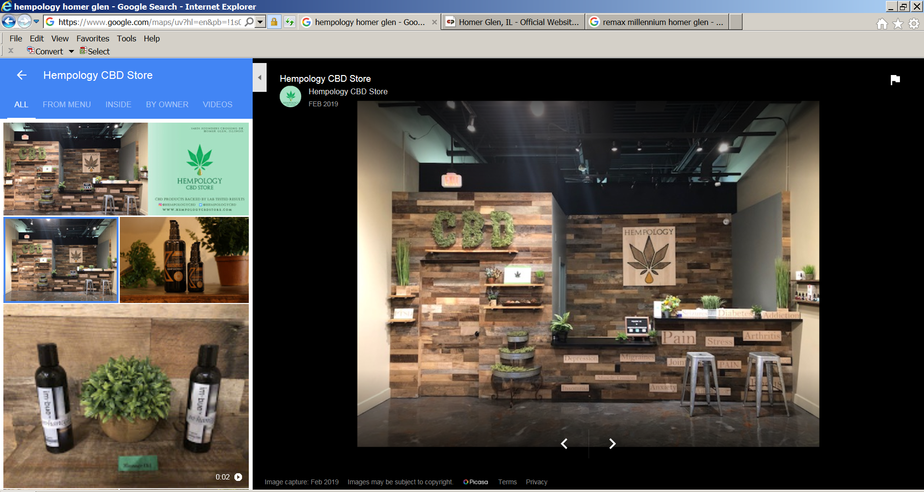
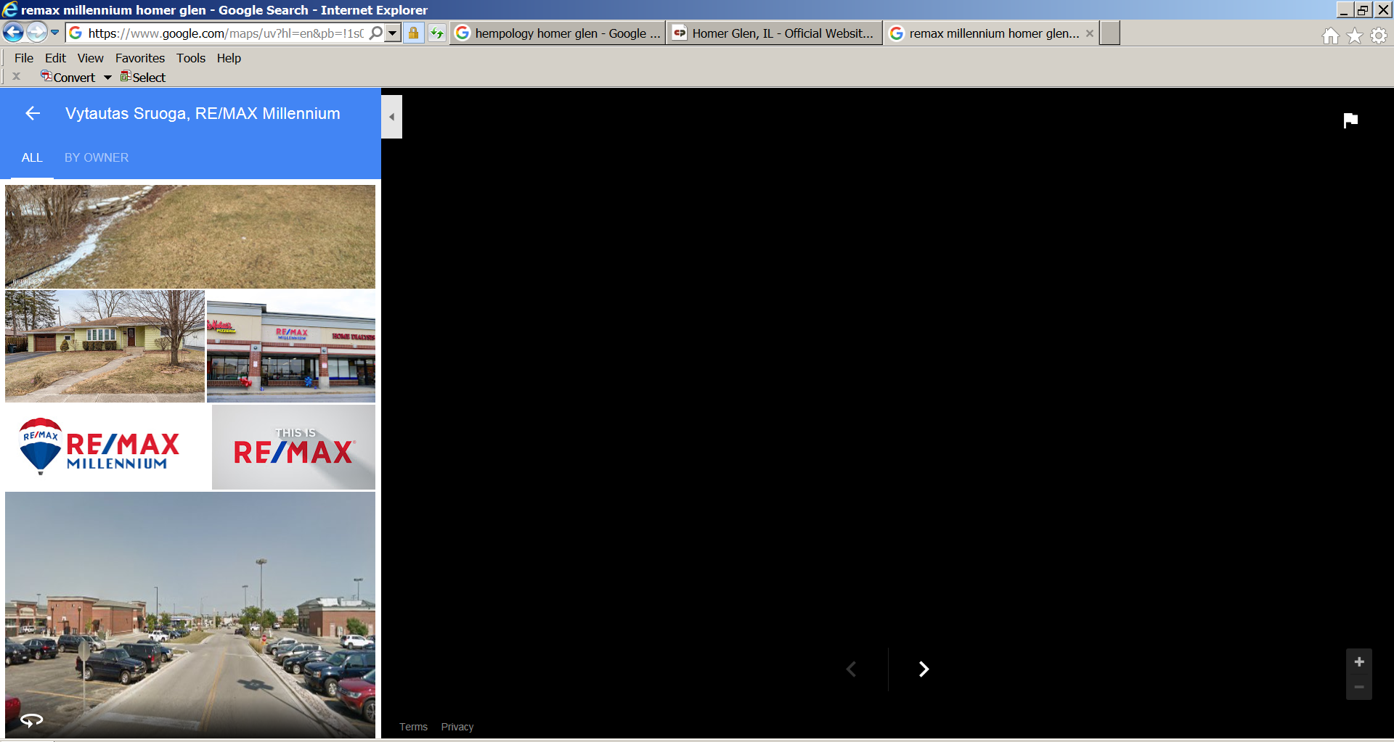
Economic Development

Slide 51
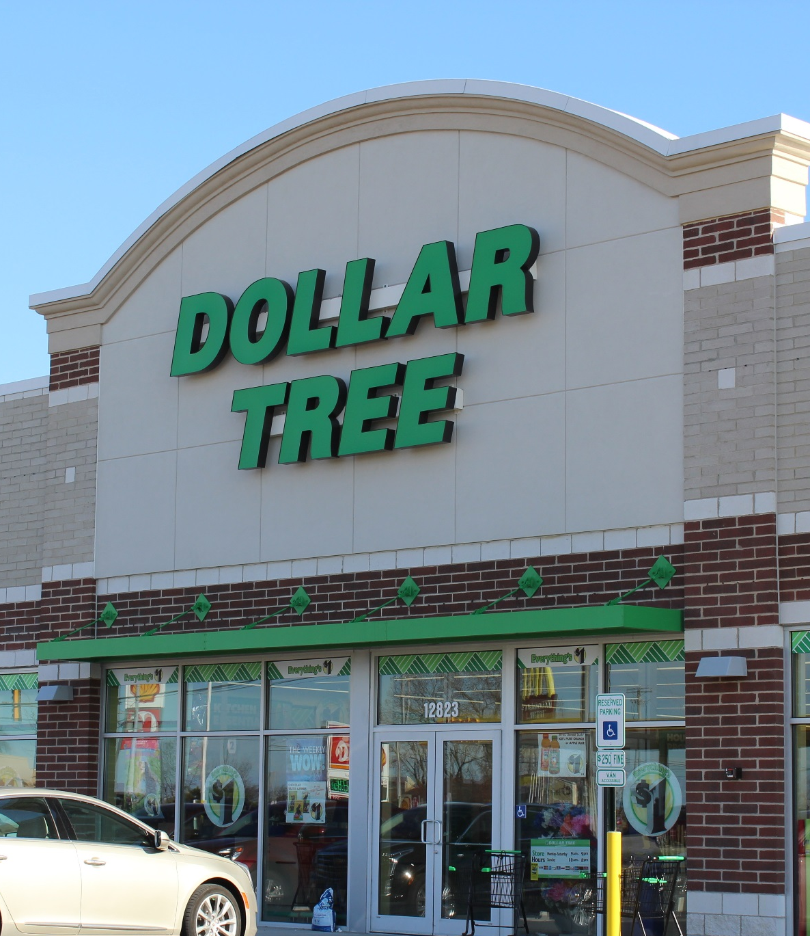
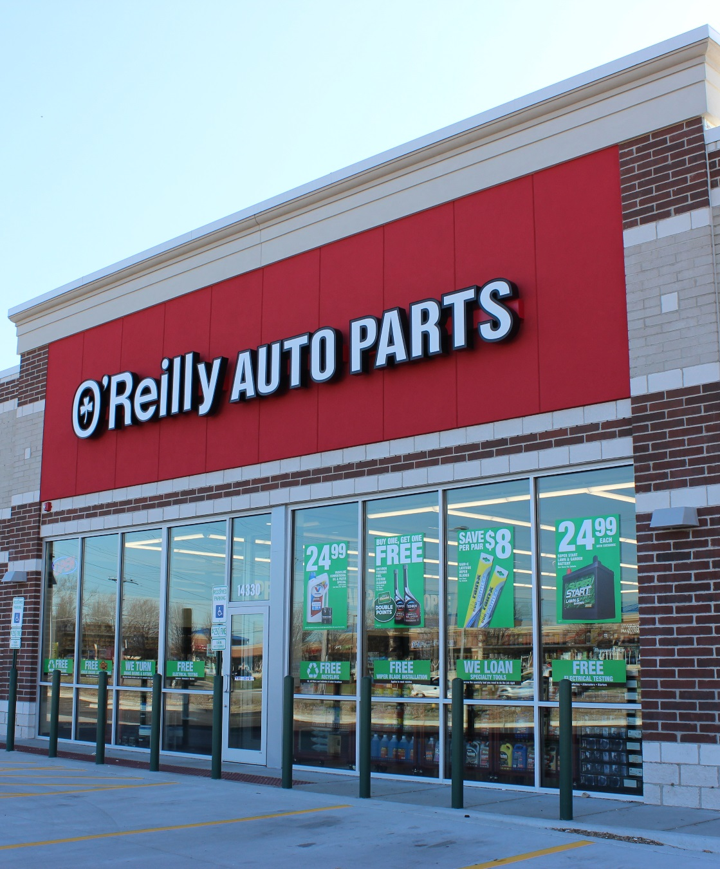
Homer Glen Bell Plaza
Economic Development

Slide 52
Homer Glen Bell Plaza
Construction Phases
I
II
III
Economic Development

Slide 53
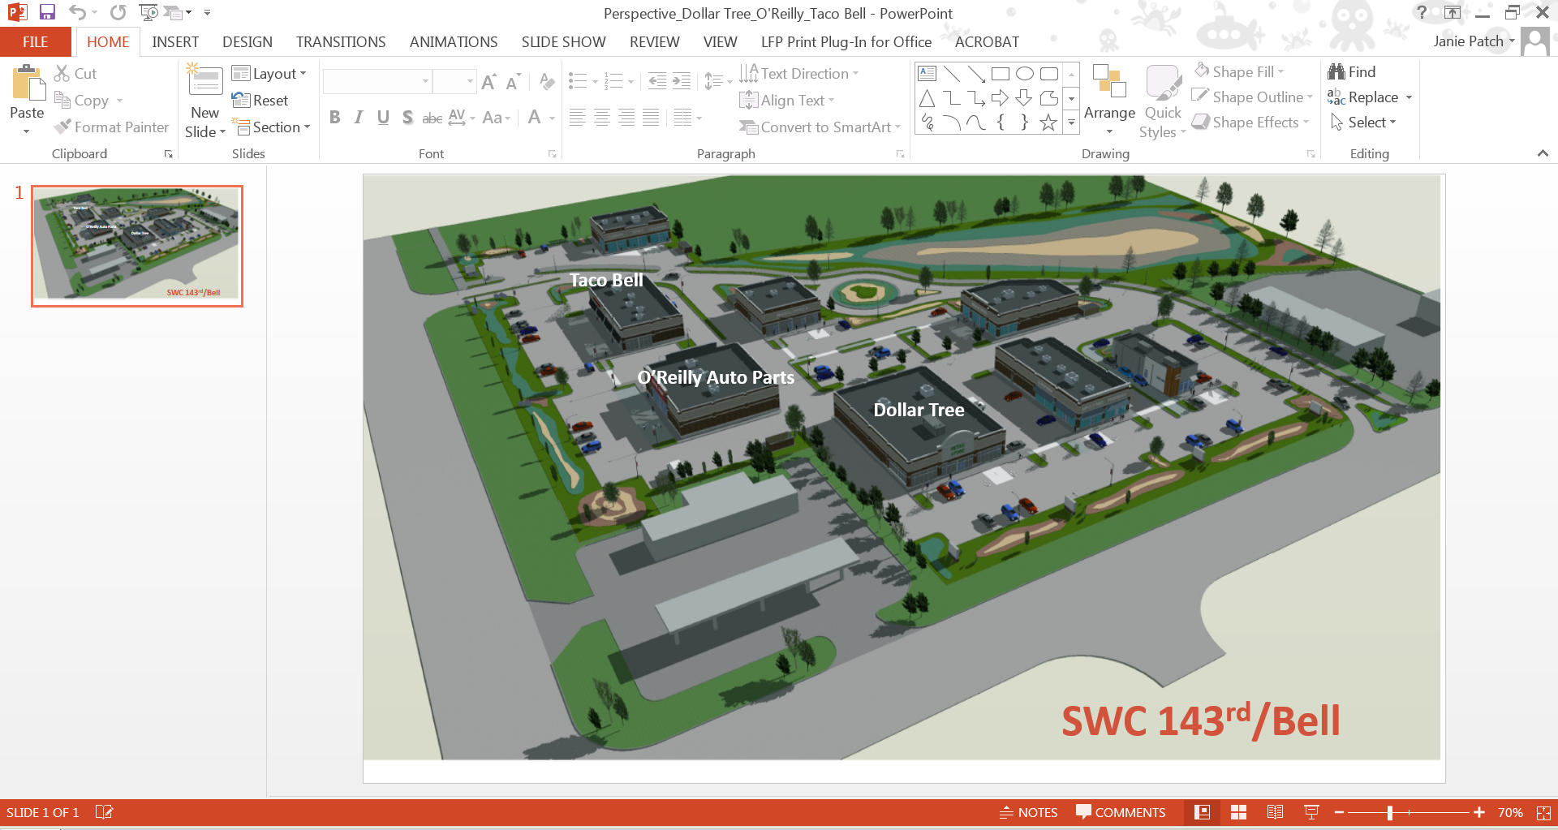

Coming Soon
Homer Glen Bell Plaza
Economic Development

Slide 54
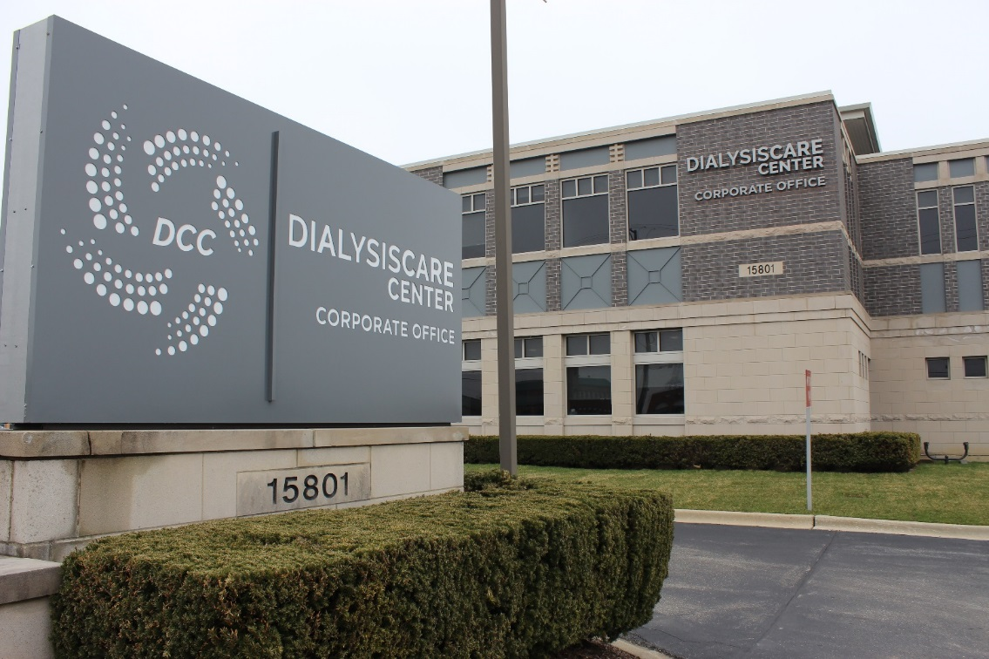
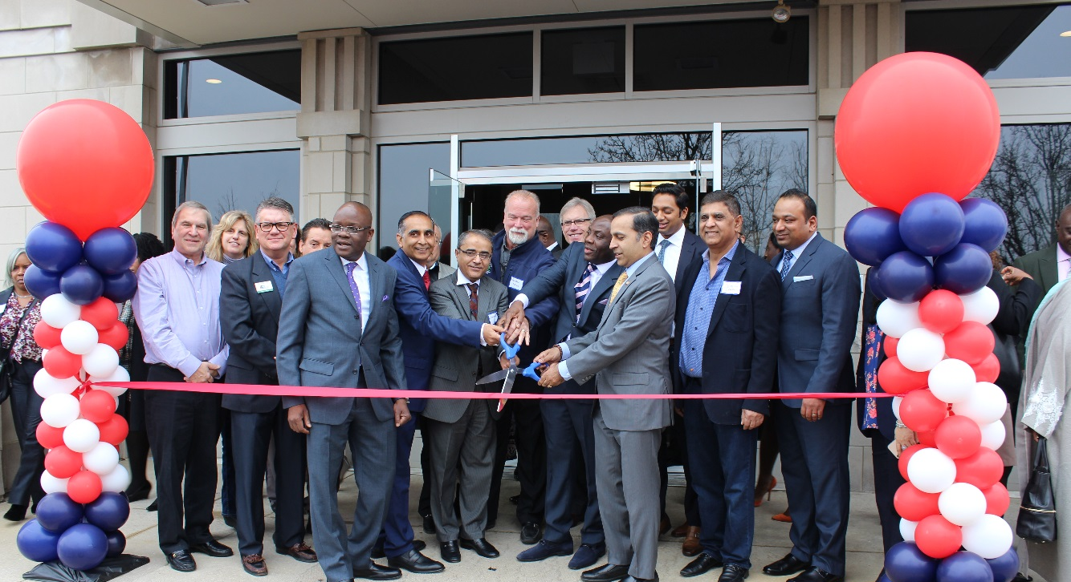
Dialysis Care Center
New Corporate Headquarters
Economic Development

Slide 55
Dialysis Care Center
New Corporate Headquarters
“The Village of Homer Glen and Mayor George Yukich have established a strong business-to-business relationship with Dialysis Care Center throughout the years, that has supported our company’s growth. Our efforts are collaborative, with approvals received in a timely manner, affirming that Homer Glen is open and ready for business.”
Dr. Babajide Salako, Chief Executive Officer, Dialysis Care Center
Economic Development

Slide 56
Future Home of
Shorewood Home & Auto
Economic Development

Slide 57
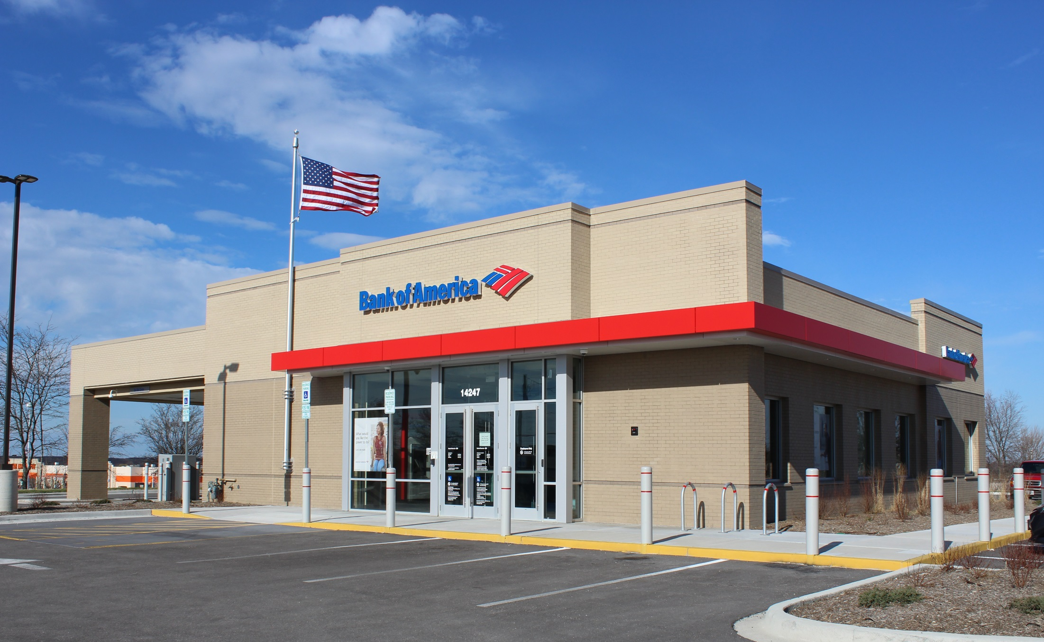
Bank of America
New Facility
Economic Development

Slide 58
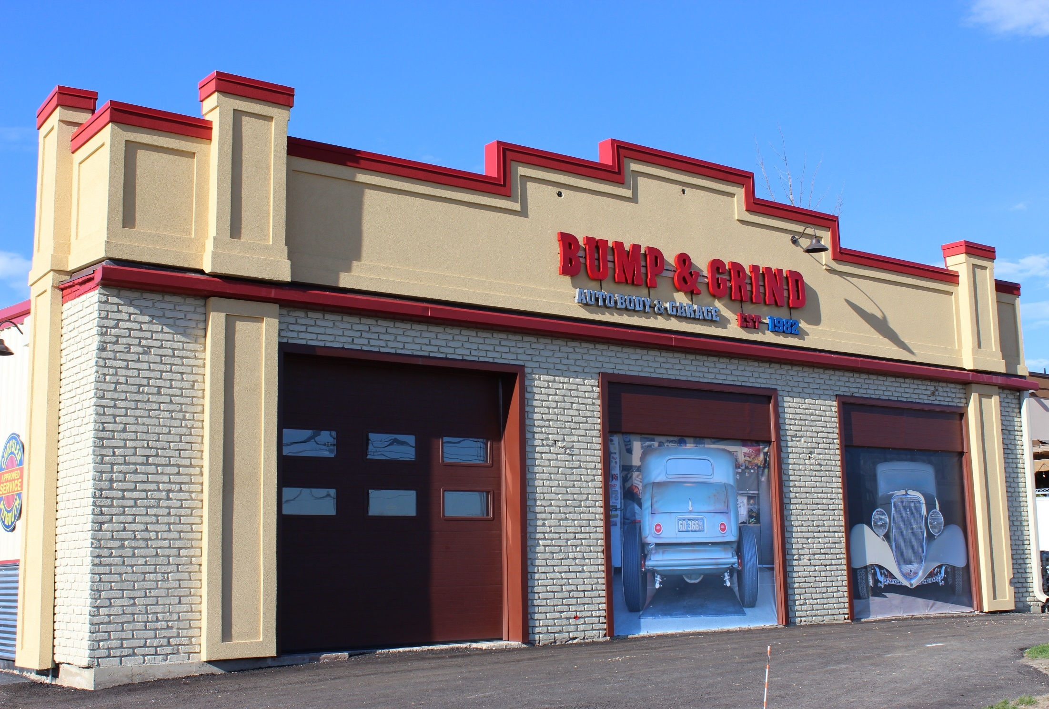
Bump & Grind Auto Body
New Facade
Economic Development

Slide 59



Marian Village Improvements
Economic Development

Slide 60


Aldi
Approved Elevation
and New Signage
Economic Development

Slide 61
32,400 SF of
Commercial Space Filled
11 New Businesses Opened
17 Existing Businesses Retained
Economic Development

Slide 62
Investment by Businesses
$5.8 Million
Economic Development

Slide 63



Coming Soon
Economic Development

Slide 64
5 Acre Site
Under
Contract
Economic Development

Slide 65
Recreational Amenities
STATE OF THE VILLAGE

Slide 66
Heritage Park

Slide 67

Heritage Park

Slide 68

319 Grant

Slide 69

Active Core

Slide 70

Bocce Ball and Pavilion

Slide 71

Challenge Course

Slide 72

Disc Golf

Slide 73


Sled Hill

Slide 74

151st Street Bike Trail

Slide 75

Future Phases of Heritage Park

Slide 76

Goodings Grove School Park

Slide 77


Goodings Grove School Park

Slide 78

Future Park Development

Slide 79
Special Events
STATE OF THE VILLAGE

Slide 80


SAVE THE DATE
JULY 13, 2019!
Chalk It Up

Slide 81

Homer for the Holidays

Slide 82

Homer for the Holidays

Slide 83

Homer Fest 2019

Slide 84

Park Planning

Slide 85

Environmental Stewardship

Slide 86

Homer Glen Ranked
#5 Safest City in Illinois
www.homesnacks.net
Safe Community

Slide 87





Tree City USA
Excellence in Financial Reporting
#5 on List of Safest Cities
in Illinois for 2019
Community Excellence

Slide 88

Shop Local ~ Invest Wisely

Slide 89

Stay Informed
www.homerglenil.org
The Village is Here for You

Slide 90

Stay Informed
www.facebook.com/villageofhomerglen
The Village is Here for You

Slide 91
Working Together for Our Future

Slide 92
STATE OF THE VILLAGE
HOMER GLEN
Mayor George Yukich
April 16, 2019

Slide 93

STATE OF THE VILLAGE

